Slide 1
A Radical Approach to Computation with Real Numbers
John Gustafson
A*CRC and NUS
±∞
–
+
“Unums version 2.0”
0
Updated June 3, 2016. Acknowledgments to Andrew Shewmaker,
Alessandro Bartolucci, and William Kahan for many helpful suggestions and corrections
Notes:
For those of you who think you have already seen unums, this is a different approach. Every one of the slides here is completely new and has not been presented before February 2016. This presentation is still being tweaked in response to people pointing out slides that need more detail, so this slide set has at least a dozen slides that were not part of the talk of the same title that was first presented at Multicore World in New Zealand.

Slide 2
Unums 1.0: upward compatible
IEEE Standard Float (64 bits):
0
10001001101
1111111000010101010011110100010101111110101000010011
sign
exponent (scale)
fraction
Flexible dynamic range
Flexible precision
No rounding, overflow, underflow
No “negative zero”
Fixes wasted NaN values
Makes results bit-identical
Self-descriptive “utag” bits track and manage uncertainty, exponent size, and fraction size
Unum
(29 bits, in this case):
utag
BUT:
Variable storage size
Adds indirection
Many conditional tests
0
11001101
111111100001
1
111
1011
sign
exp.
frac.
ubit
exp. size
frac. size
Notes:
I need to start with a very quick overview of the original unum format, for those of you who have not seen it before. Standard floats have a sign bit and two fields of a prescribed size for the exponent and fraction. Unums 1.0 were designed to be upward compatible extensions of standard floats, to make adoption easier. The example shows how adding self-descriptive tag fields can more than pay for themselves in helping to abbreviate the number of bits needed. Both bit strings represent the physical constant Avogadro’s number, about 6.022 times ten to the 23rd.
The drawback is the variable length of a unum, and the fact that you have to “look up” the exponent size and fraction size before you can actually fetch them. That means a level of indirection, which is never good for performance since it cannot be parallelized. Also, the prototype code for this type of unums is rich in conditional branches, and any hardware version would have to echo those tests, resulting in pipeline stalls and data-dependent execution times.

Slide 3
What would the ideal format be?
All arithmetic operations equally fast
No penalty for decimal instead of binary
Easy to build using current chip technology
No exceptions (subnormals, NaNs, “negative zero”…)
One-to-one: no redundant representations
Onto: No real numbers overlooked
Upward compatible with IEEE 754
Mathematically sound; no rounding errors
IEEE 754 compatibility prevents all the other goals.
Notes:
Suppose we instead start tabula rasa, a clean-slate approach to designing a number system. Forget about ties to the positional numerical notation that dates back thousands of years, and use more recent information theory and set theory. What would you want from a numerical format for real values? I’ve listed some here, and they compete with one another just as so many lists of engineering goals do. However, the one that some religiously cling to is the one that prevents us from satisfying all the others: compatibility with the IEEE 754 floating point standard! If we are willing to break from that, amazing things become possible.

Slide 4
Break completely from
IEEE 754 floats and gain:
Computation with mathematical rigor
Robust set representations with a fixed number of bits
1-clock binary ops with no exception cases
Tractable “exhaustive search” in high dimensions
Strategy: Get ultra-low precision right, then work up.
Notes:
The original unums had sign, exponent, and fraction fields just like IEEE floats and obeying most of the same rules; those unums had three metadata fields, the “utag”, that described the exact-inexact state, the exponent size, and the fraction size, and they therefore had variable length. This new approach makes a complete break from IEEE float compatibility and redesigns the way we represent the infinite space of real numbers on a computer.
They are just as mathematically rigorous as before, but the clear up the remaining clunkiness of the IEEE format. They are so terse and so fast that you can think about solving very difficult equations by trying the entire real number line, overlooking nothing.
As was done in The End of Error: Unum Computing, we start with ultra-low precision and make the foundation of the method perfect before we go after larger numbers of bits for higher accuracy.

Slide 5
All projective reals, using 2 bits
10
±∞
“±∞” is “the point at infinity” and is unsigned.
Think of it as the reciprocal of zero.
–
+
11
01
0
00
Notes:
This is the “scaffolding” on which all the unums are built. The projective real line is an old idea, but mapping it to 2’s complement integers seems to be a new idea. Something like this was considered for IEEE floats, but rejected by engineers who wanted separate representations of positive and negative infinity. Later we will show that we still have their equivalent and do not need to give them up at all.

Slide 6
Linear depiction
all negative reals
(–∞, 0)
exact
0
all positive reals
(0, ∞)
±∞
10
11
00
01
Maps to the way 2’s complement integers work!
Redundant point at infinity on the right is not shown.
Notes:
Here is the more common way of depicting real numbers, as points on a line. The four binary numbers shown, if they were signed integers, would be –2, –1, 0, and 1. If you add 1 to 1, it “wraps” around to –2, the same way positive infinity “wraps” to negative infinity. “±∞” is sometimes called “the point at infinity”. It seems like we have lost the ability to distinguish between positive infinity and negative infinity, but this will turn out not to diminish our ability to do anything.

Slide 7
Absence-Presence Bits
±∞
(–∞, 0)
0
(0, ∞)
0 (open shape) if absent from the set,
1 (filled shape) if present in the set.
Rectangle if exact, oval or circle if inexact (range)
Red if negative, blue if positive
10
11
00
01
⬆︎
or
⬇︎
⬆︎
or
⬇
⬆︎
or
⬇
⬆︎
or
⬇
Forms the power set of the four states.
2⁴ = 16 possible subsets
of the extended reals.
Notes:
This is where the concept really starts to depart from what you normally think of as numerical computing. The positional notation of a set of bits can be used to mark the presence or absence of a positional set of bits, that is, unums. Color-coding helps. Instead of using 0s and 1s, we use open and filled shapes. That way, it’s less likely that you will confuse a string of 0-1 bits representing a unum with the open-filled bits representing whether a particular unum is absent or present in a set of unums. We need a new name for this set of absence-presence bits. Next slide.

Slide 8
Sets become numeric quantities
The empty set, { }
“SORNs”: Sets Of Real Numbers
All positive reals (0, ∞)
Zero, 0
Closed under
x + y x – y
x × y x ÷ y
and… x^{y}
All nonnegative reals, [0, ∞)
All negative reals, (–∞, 0)
All nonzero reals, (–∞, 0) ∪ (0, ∞)
All nonpositive reals, (–∞, 0]
All reals, (–∞, ∞)
Tolerates division by 0.
No indeterminate forms.
Very different from symbolic ways of dealing with sets.
The point at infinity, ±∞
The extended positive reals, (0, ∞]
The unsigned values, 0 ∪ ±∞
The extended nonnegative reals, [0, ∞]
The extended negative reals, [–∞, 0)
All nonzero extended reals [–∞, 0) ∪ ( 0, ∞]
The extended nonpositive reals, [–∞, 0]
All extended reals, [–∞, ∞]
Notes:
Call them “SORNs”, and that really is an acronym so it should be in capital letters. “Unum” is just short for “universal number” so it’s not an acronym and should not be capitalized, though everyone seems to want to capitalize the entire word.
Notice how much more expressive this is than interval arithmetic. It is actually possible to do useful calculations with this set of SORNs, where (for example) all we need to know about a result is its sign. Or you could show that x² + 1 has no roots on the entire real number line by evaluating x² + 1 on (-∞, ∞) and getting the result (0, ∞) which proves the polynomial is never zero for any real x.
These things form a closed set, and there are no indeterminate forms! More about that on the next slide. There are symbolic manipulation programs like Mathematica that can handle sets, but they do it with list processing and not numerically. A SORN is a number, subject to bitwise operations. Needless to say, that is a lot faster than working with list representations. Plus, it becomes possible, even easy, to put into hardware form.

Slide 9
No more “Not a Number”
√–1 = empty set:
0 / 0 = everything:
∞ – ∞ = everything:
1∞ = all nonnegatives, [0, ∞]:
etc.
Answers, as limit forms, are sets.
We can express those!
Notes:
When you get a NaN result with IEEE, about the only choice you have is signaling NaN (stop the computation) or quiet NaN (keep going, but the NaN will propagate to all results that make use of the number). All that goes away with SORN representation. if there are no real numbers that solve a problem, like the square root of a negative number or the arcsine of 3, then the answer is the empty set. If you ask for zero divided by zero or infinity minus infinity or zero times infinity or any of the other classic “indeterminate forms”, you get the entire extended real number line because the answer could be anything. IEEE floats would tell you NaN for both situations, so they cannot distinguish between the very opposite concepts of NOTHING and EVERYTHING!
There are actually a lot of forms of expressions where the answer is a set and not a point value. 1 to the infinity power, as a limit, can be anything from 0 to positive infinity. So the answer is as shown: everything but the negative real numbers. This is a lot more expressive than just throwing up your hands and saying, “It’s not a number! I can’t go on!” It’s a set of numbers, and a contiguous set at that, so keep on computing.

Slide 10
Op tables need only be 4x4
Hardware flag: independent x and y
+
For any SORN, do table look-up for pairwise bits that are set, and find the union with a bitwise OR.
+
parallel OR
Note that three entries “blur”, indicating information loss.
Notes:
If I sort the inputs x and y so that x is always less than or equal than y (as a bit string), then I only need about half the table since addition is commutative, x plus y is the same as y plus x. I could just have 12 entries instead of 16. The savings gets a lot closer to 2x for larger SORN strings, obviously.
The point is that even though there are 16 possible input SORNs, you can deal with the arithmetic one bit at a time, and then OR all the results together because that’s how you take the union of two SORNs. (To intersect two SORNs, which is also sometimes very useful, you simply AND their bit strings).
If you add ±∞ to ±∞, you get everything. If you add (0, ∞) to (–∞,0) then you get all real numbers, (–∞, ∞). Those create three cases where the arguments may be single-bit SORNs but the result of the operation lights up several contiguous points in the SORN representation. This is an early taste of what happens with more precise numerical arithmetic. If the result of a math operation is not exactly expressible with a single unum, it will spread across multiple unums. But the computer can automatically keep track of that spreading.

Slide 11
Compiler-Hardware Interaction
Hardware flag: dependent x and y. (y = x)
+
If a variable occurs more than once, only reflexive combinations are needed.
+
parallel OR
Compiler detects common sub-expressions, so x + x is handled differently from x + y
Notes:
Here is a foreshadowing of a concept that deserves a lot more discussion. When a variable occurs more than once in an expression, like f(x) = square root of x plus the square of x, say, how do you let the hardware know not to use all possible combinations of x with itself? It’s really not difficult. You set a flag that says this is a “dependent” operation so you only need the diagonal of the operation tables, and you defer taking the union of each SORN result until you are all the way through the function f. This accomplishes some of the same things that affine arithmetic does, but with brute force computing instead of having to teach people what affine arithmetic is (good luck with that)!
The need for a compiler to detect common sub-expressions suggests to me that it might not be enough to extend C or some other language with new data types; we also need to insist on standard ways to recognize dependencies between expressions and how to express that the union of SORNs is deferred to the end of a function. I suspect the logical place to test for accuracy loss is at the end of a function, and that way a computer can automatically detect insufficient accuracy or allow the programmer to control where such detection occurs. But I will come back to this a bit later in the talk.

Slide 12
Now include +1 and –1
100
101
±∞
011
The SORN is 8 bits long.
This is actually enough of a number system to be useful!
(–∞,–1)
(1,∞)
110
–1
+1
010
(–1,0)
(0,1)
111
0
001
000
Notes:
Now that you’ve gotten used to 4-bit unums and their 16-bit SORNs, let’s add just one more bit to the unum so that we can represent +1 and –1, as well as the open intervals between those numbers and the two values we had before, 0 and ±∞. To show that such a simplistic system is actually useful, we will use it to solve a very real problem, one that has vexed the robot-building community for many years.

Slide 13
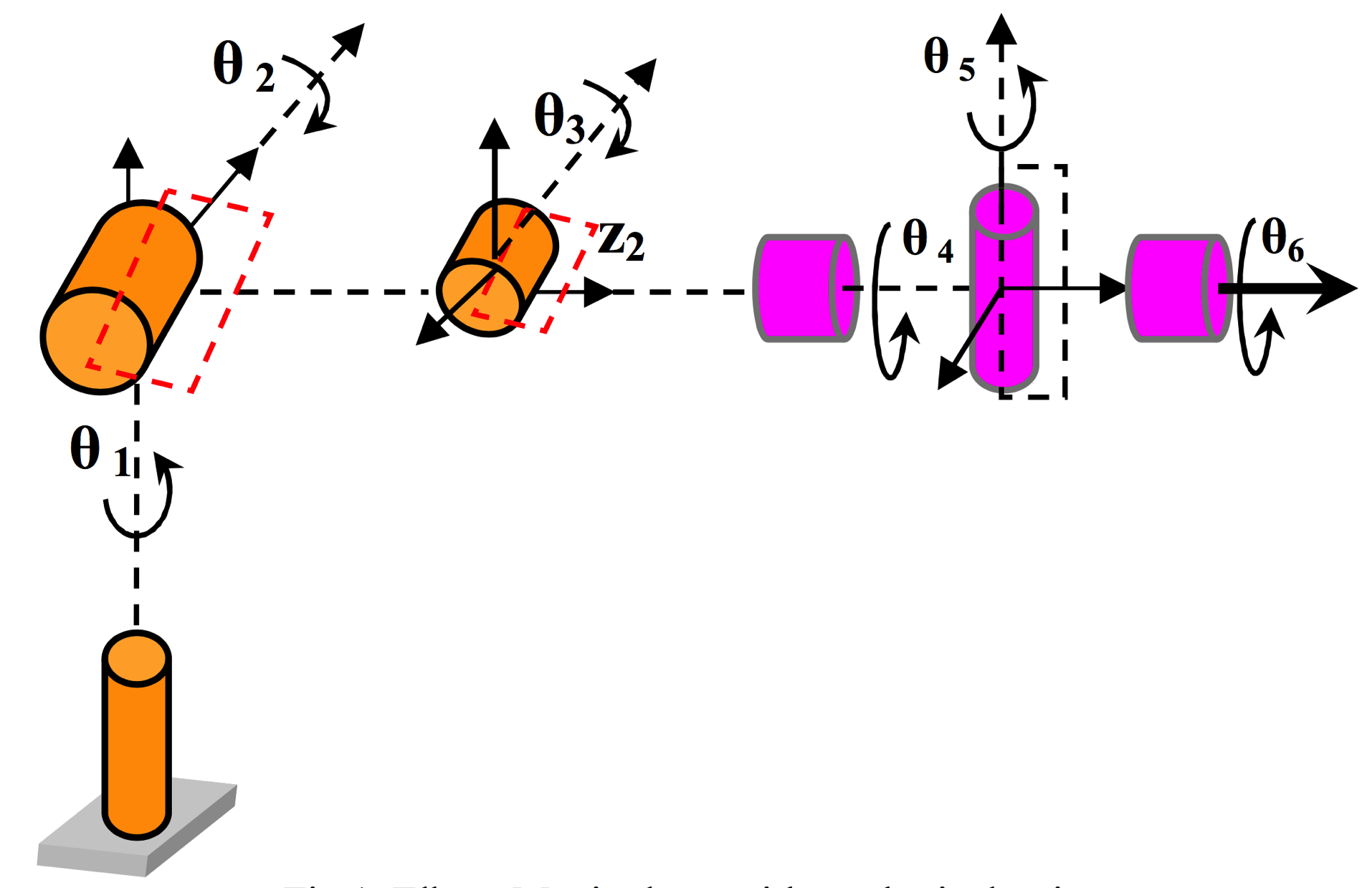
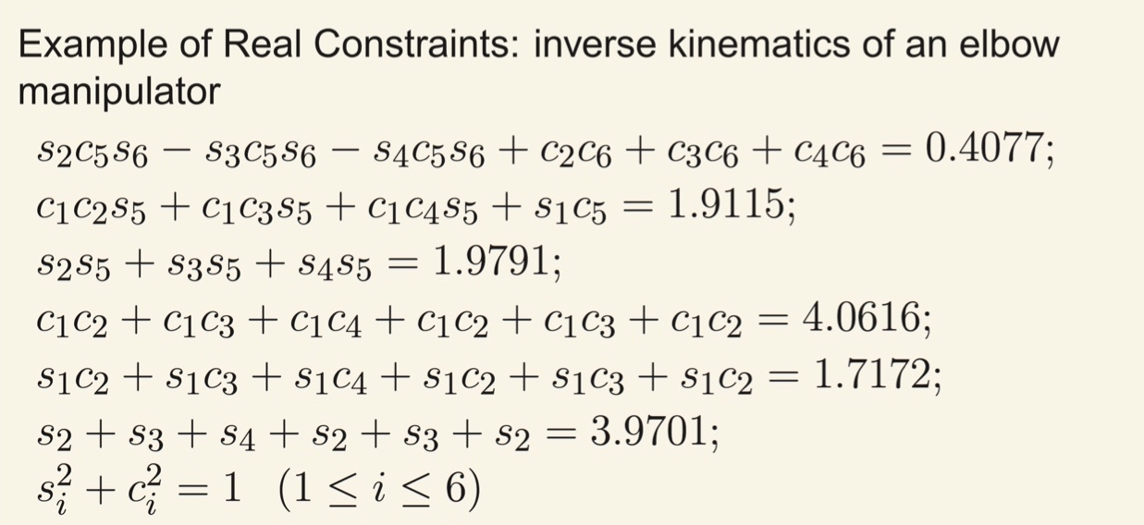
Example: Robotic Arm Kinematics
12-dimensional nonlinear system (!)
Notice all values
must be in [–1,1] ➔
Notes:
A colleague of mine at NUS, Roland Yap, popped his head into my office one day and asked, “Your number types… can the solve a problem like this?”
I always prefer problems supplied by others. When people write papers about new numerical approaches, I notice they almost always think up their own problems, and their methods miraculously work very well for that cherry-picked problem. It’s much more interesting when you have no control over what problem someone throws at you.
Just look at this mess. Twelve variables, and all but one of the equations is nonlinear! Think you can solve it by algebraic substitution? It’s hopeless. How about a numerical method where you use gradient search? That could be very slow, and you have no idea how many solutions there are, or even if there are any solutions. How about “box consistency”, where you plug in an interval for all but one variable, and use that to restrict the possible interval range of that one variable? I soon found that doing so produced looser bounds, not tighter ones. Incidentally, I only found the picture in the top left by searching the web for “robot kinematics”, and once I did, I realized that “s” and “c” stand for sine and cosine of the six possible angles.
The last equation trivially proves that all s and c values are between –1 and +1. Well, of course; they’re sines and cosines of the six possible angles in the picture. But other than that… where to start?
Suppose we do the unthinkable, and try everything? If we split each range –1 to +1 into two ranges, –1 to 0 and 0 to +1, those are unum sets in the three-bit representation. Can you imagine how quickly a computer can compute if it only has to operate on three bit quantities? Think picoseconds, not nanoseconds. OK, here we go…

Slide 14
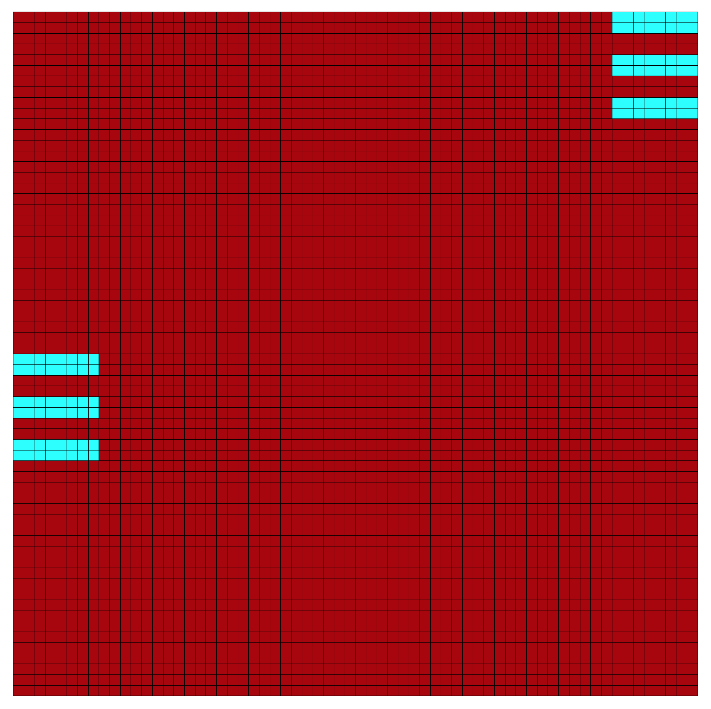
“Try everything”… in 12 dimensions
Every variable is in [–1, 1], so split into [–1, 0) and [0, 1] and compute the constraint function to 3-bit accuracy.
■ = violates constraints
■ = compliant subset
2¹² = 4096 sub-cubes can be evaluated in parallel, in a few nanoseconds.
Notes:
There are two to the sixth possible ways to split the s values, or 64 ways they could be less than zero or greater than zero, and similarly 64 ways to split the c values. Those are the two axes of the grid. But look at all the possibilities that immediately were ruled out, shown in red. Almost all of them! The light blue squares are the only combinations that were compliant with all twelve equations. Those 4096 sub-cubes could be evaluated in parallel, like a GPU might be able to do, say. This is a huge reduction in the space that needs to be searched. At this point you could switch to your favorite higher-precision search method, but at least you would have a far smaller volume of space to explore.
Remember that this is a 12-dimensional space unfolded repeatedly to show it in two dimensions. If you could think in 12 dimensions, the light blue regions would form two contiguous lumps in 12-space, not the six that appear disconnected here.
I want to come back to this robotics problem in a bit. Right now, we have to stop since I’ve only defined three real numbers: 0, –1, and 1, so maybe it’s time to get some more values into our system.

Slide 15
One option: more powers of 2
1000
1001
0111
There is nothing special about 2. We could have added 10 and 1/10, or even π and 1/π, or any exact number.
(Yes, π can be numerically exact, if we want it to be!)
1010
±∞
0110
–2
2
1011
0101
1100
–1
1
0100
1101
0011
–1/2
1/2
1110
0
0010
1111
0001
0000
Notes:
Even the aboriginal people of Australia and South America, who have little need for mathematics, have words for “one” and “two”. So let’s put the number 2 into the mix. Of course we need –2 as well. On the bottom half of the circle, we use the reciprocals of 2 and –2. Notice that the reciprocal of every number on the circle is its reflection about the horizontal axis!
It didn’t have to be 2. It could have been any finite number greater than 1. And I do mean any number, You could use the square root of 2, or pi, and generate its negative and the two reciprocals. This is the point in the system where we can exercise human choice; the four values 0, +1, ±∞, and –1 are mathematically dictated by the rules for addition, subtraction, multiplication, and division, but the rest of the numbers present some flexible choices. I get funny reactions when I tell people that pi is an exact number. They say, “No it’s not! No matter how many decimals you use, it’s never exact!” That confuses the decimal approximations we tend to think in, with the actual meaning of the number pi. Pi is exact, folks. And it can be an exact number in the computer sense, if the computer number format needs it to be. Again, this is not symbolic mathematics like Maple and Mathematica use; it’s numerical computing with pure bit-level operations.

Slide 16
Note: sign bit is in the usual place
1000
1001
0111
±∞
The sign of 0 and ±∞ is meaningless, since
0 = –0 and
±∞ = –±∞.
1010
0110
–2
2
1011
0101
1100
–1
1
0100
1101
0011
–1/2
1/2
1110
0
0010
1111
0001
0000
Notes:
If you’ve read my book, you know how much I like color-coding to make bit strings more legible. Happily, we can still identify the first bit as the “sign bit”, so it is colored red here as I did in my book. I used red because of the financial convention of red ink meaning negative numbers.
However, notice that the sign bit is meaningless for two values: zero and ±∞. This system does away with the IEEE headache known as “negative zero”. The IEEE rules for dealing with signed zero are so arbitrary and groundless that they have produced grief for hardware designers for thirty years. My personal favorite is the rule that says the square root of negative zero must be negative zero. Right. And that is based on what mathematical concept, exactly?

Slide 17
Negation is trivial
1000
To negate, flip horizontally.
Reminder: In 2’s complement, flip all bits and add 1, to negate. Works without exception, even for 0 and ±∞. (They do not change.)
1001
0111
1010
±∞
0110
–2
2
1011
0101
1100
–1
1
0100
1101
0011
–1/2
1/2
1110
0
0010
1111
0001
0000
Notes:
If you have forgotten how to negate a 2s complement number, you’re not alone. It’s not as simple as flipping the first bit, the way it is for sign-magnitude arithmetic. The very first electronic computers from IBM used sign-magnitude representation, and the IEEE float standard is based on that. But 2s complement has displaced sign-magnitude pretty universally these days, partly because it doesn’t have a redundant representation of zero.
So the rule is: flip all the bits, and add 1. Ignore the overflow, if there is any; just save the number of bits you start with. So for zero, you take 0000, flip it to 1111, add 1 and it overflows to 0000 so you’re back where you started. The same for the representation of ±∞; when you flip the bits and add 1, it turns 1000 back into 1000. No more conditional tests in the software or hardware for the goofy case of negative zero. It just works.
Geometrically, just flip the circle about its vertical axis.

Slide 18
A new notation: Unary “/”
Just as unary “–” can be put before x to mean 0 – x,
unary “/” can be put before x to mean 1/x.
Just as we can write –x for 0 – x, we can write /x for 1/x. Pronounce it “over x”
Parsing is just like parsing unary minus signs.
– (–x) = x, just as / (/x) = x.
x – y = x + (–y), just as x ÷ y = x × (/y)
These unum systems are lossless (no rounding error) under negation and reciprocation.
Arithmetic ops + – × ÷ are on equal footing.
Notes:
OK, this is a big one. Other than the SORN slide, this may be the most disruptive idea in this slide deck. I’m proposing a fundamental change to the way we commonly write and read numbers, one that conceivably could be taught in grade school from now on.
The term “unary minus” means a minus sign that negates the value that follows, as opposed to the kind of minus we mean when we write x – y. We can abbreviate zero minus x as just, minus x. Leave out the zero. We could do the same thing for 1/x, and leave off the 1. Instead of saying “one over x” we would just say “over x”.
We know that compilers can parse unary minus signs; they’ve been doing it for sixty years. It should not be at all difficult for them to parse the “over” sign, unary “/”.
Notice that two unary minus signs cancel out. The negative of the negative of a number gives us back the positive. Similarly, the reciprocal of the reciprocal of a number gives us back the number. Usually you have to make an exception for dividing by zero, but we don’t with this system. The reciprocal of zero is ±∞, and the reciprocal of ±∞ is zero.
As anyone who has ever used a pocket calculator knows, dividing x by y is not the same as multiplying x by 1/y. Like, if you divide 3 by 3 you will get exactly 1 on a calculator or a computer. But if you multiply 3 by the rounded calculator version of 1/3, you will get a number close to 1, but not quite! Which can be pretty disastrous in even the simplest of computer programs, like when you are trying to use these small integers or fractions to decide how many times to execute a loop of code. Sometimes, the rounding errors cancel out and x times 1/y is the same as x/y, but you certainly cannot count on that to happen. Thank you, Dr. Kahan, for reminding me that cases like 6/3 = round(6 * round(1/3)) = 2 exactly do exist.
We’ve long had the ability to negate numbers without any loss of accuracy or information. But reciprocation has always been sloppy, and you cannot take 1/x with floats and land exactly on another float unless you’re very lucky, so you experience rounding errors just with the simple act of asking for a reciprocal. Suppose going from 3 to 1/3 was as simple as writing “–3” for the negation of 3? You write “/3” and that is the answer. That is the way the computer stores it internally, and that is the way it displays the result for humans to read and understand. As I said, this probably has to be taught starting at the elementary school level at the time they introduce negative numbers, fractions, and decimals. They are just as hard to understand at first as fractions and decimals, and just as easy to understand after you get used to that notation.
I sometimes say that “division is the ‘bad boy’ of arithmetic.” It’s the hardest one to learn in school and the slowest to execute on a computer. Remember the notorious Intel Pentium Divide Bug? That was the result of aggressive attempts to raise the speed of divides on a microprocessor, since divides are quite a bit slower than multiplies the way we do things now. But the system described here makes all four arithmetic operations equally simple, equally symmetric, equally fast.

Slide 19
Reciprocation is trivial, too!
1000
To reciprocate, flip vertically.
Reverse all bits but the first one and add 1, to reciprocate. Works without exception. +1 and –1 do not change.
1001
0111
1010
/0
0110
–2
2
1011
0101
1100
–1
1
0100
1101
0011
–/2
/2
1110
0
0010
1111
0001
0000
Notes:
Back the the real number circle. To find the reciprocal of a number, find its reflection about the horizontal axis, as I mentioned earlier. That has a simple bitwise operation just like negation: Flip all the bits but the first one, add 1, and ignore any overflow. Pretty cool, huh? Like for the unum that represents +1, 0100, you flip the right three bits from 100 to 011 to get 0011, then add 1, get 0100 back again, so 1 turns into… 1. Do we need exceptions for 0 and ±∞? No. They work fine. 0000 becomes 0111, add 1 to get 1000, which is the unum representing ±∞. And vice versa.
I slipped something in here. Do you see what I did to the green numbers? I started to use the unary “over” notation. So instead of writing plus-or-minus infinity, I can just write over-zero. Which is a lot easier to do from a computer keyboard, let me tell you! it may look a little odd to see “–/2” for negative one-half, but you get used to it. It saves a character, too.

Slide 20
The last bit serves as the ubit
1000
ubit = 0 means exact
ubit = 1 means the open interval between exact numbers.
“uncertainty bit”.
1001
0111
1010
/0
0110
–2
2
1011
0101
1100
–1
1
0100
1101
0011
–/2
/2
1110
0
0010
1111
0001
Example: This means the open interval (½, 1). Or (get used to it), (/2, 1).
0000
Notes:
Another bit that can be picked off as having meaning is the last one: it is a ubit, just as it was with the IEEE-compatible version of the definition of unums. “Ubit” is short for “uncertainty bit”. If the ubit is zero, the value is exact. If it is 1, the value is the open interval between adjacent exact values. Notice how it’s monotone increasing that way. As you count up the 2s complement integer, you walk from left to right along the real number line. The less-than, greater-than relationship is perfect except for the overflow point at /0. which is where comparisons also have an exception for integers. I like to color-code the ubit in magenta, as you see here. I also try to use Courier monospace typeface for binary numbers, but Times or Arial for decimal numbers like the green ones shown here.
Now you can see how we could represent plenty of numbers along the circle. Let’s return to the robotics problem.

Slide 21
Divide by 0 mid-calculation and still get the right answer
What is 1 / (1/x + ½) for –1 < x ≤ 2?
/0
/0
–2
2
–2
2
–1
1
–1
1
–/2
/2
–/2
/2
0
0
10-unum SORN
for x = (–1, 2]
lossless SORN
for 1/x = [½, –1)
Divide by zero is an ordinary operation.
Notes:
Even at this extremely low accuracy, it is possible to demonstrate the power of this approach. We can evaluate the function as shown without doing any algebraic rearrangement to remove the division by zero. (The function is the same as 2x / (x + 2), so it has a singularity at x = –2 but not at zero. The apparent singularity at zero is removable with symbolic manipulation, but not with conventional computer arithmetic.) The SORN has 10 presence bits set to represent the half-open interval (–1, 2]. Begin by taking the reciprocal, which is lossless and preserves the contiguity of the unums in the result.

Slide 22
Add ½, reciprocate again
/0
–2
2
Add ½
–1
1
/0
–2
2
–/2
/2
Reciprocate
0
–1
1
lossless SORN
for 1/x + ½ = [1, –½)
–/2
/2
0
lossless SORN
for 1/(1/x+½) = (–2, 1]
Notes:
The next step, adding ½, involves some blurring of results because, for example, the exact number 2 when added to ½ winds up in the open range (2, /0). It is still lossless since the endpoints land on the correct values in this case. The final reciprocation gracefully turns the infinite value back into zero, so there was no reason to press the panic button in that first step where we took 1/x and x included zero.
It is still true that zero divided by zero in a calculation will destroy information since the result will be the entire extended real line, [-∞, ∞].
I don’t have space to show it here, but similarly elegant things can be done, say, solving two equations in two unknowns and not having to worry about the rank of the matrix. Singular matrices just aren’t as scary as they used to be.

Slide 23
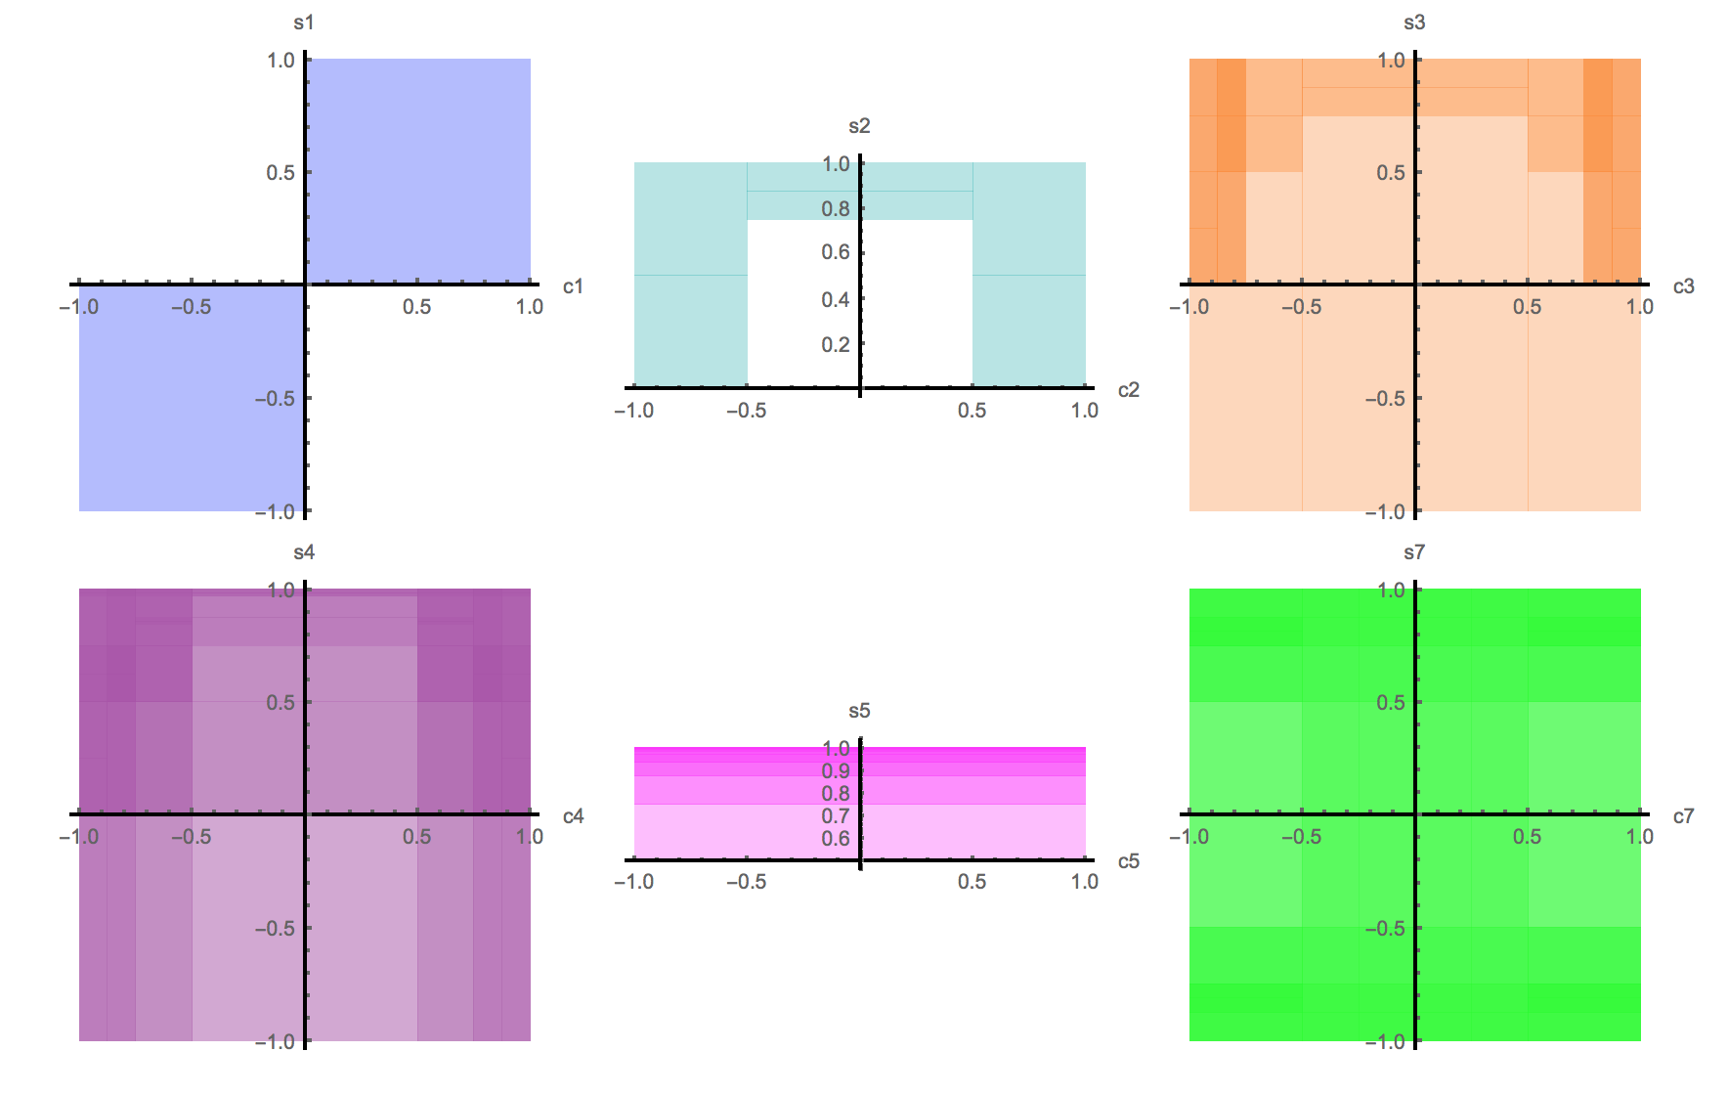
Back to kinematics, with exact 2^{k}
Split one dimension at a time.
Needs only 1600 function evaluations (microseconds).
Display six 2D graphs of c
versus s (cosine versus sine… should converge to an arc)
Here is what the rigorous
bound looks like after
one pass.
Information = /uncertainty.
Uncertainty = answer volume.
Information increases by 1661×
Notes:
This time, instead of splitting every dimension at once, split one dimension at a time and check for compliance with the twelve equations. When people compare optimization methods, they like to score them by how many times they have to evaluate the function being optimized. That’s fine, though it does reduce the amount of parallelism you might be able to exploit. There’s still a lot of parallelism, don’t worry, because after a few splits you get hundreds of candidate sub-cubes that can be split and examined simultaneously. By the way, we could have made use of the insight that the c and s values are sines and cosines and solved this with only six angle variables instead of twelve variables, but the point here is to be able to solve problems mindlessly, using the brute force power of a computer with a massive number of processors and a number system that can be trusted, unlike floats.
Define information as the reciprocal of uncertainty, where for any particular problem we can define the uncertainty as the volume of the answer space in however many dimensions the problem is. So we started with an answer volume of 2¹² = 4096. With only 1600 function evaluations, we reduced the bounding volume by a factor of 1661 times. You can just barely see arcs starting to take shape. And notice that the c-s space in the top left shows two separate solution regions. A typical search method would only have found one of those two regions; we can instead search for all of them at once.

Slide 24
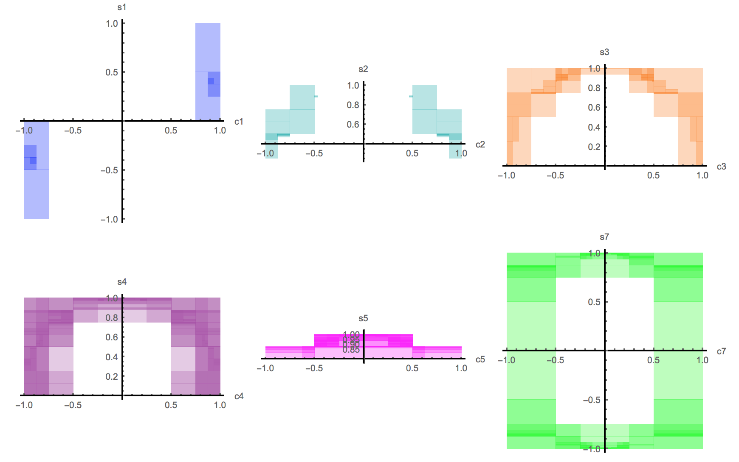
Make a second pass
Still using ultra-
low precision
Starting to look
like arcs
(angle ranges)
457306 function
evaluations (μsecs,using parallelism)
Information increases by a factor of 3.7×10⁶
Notes:
Here it is after a second pass. I’m estimating that these function evaluations are super-fast because they involve so few bits; more on that in the next few slides, but I believe the refinement you see here can be obtained in milliseconds even if only a single processor is used. If you have plenty of tiny processors capable of this low-precision math, then it’s still microseconds to get this far. Let’s do just one more pass.

Slide 25
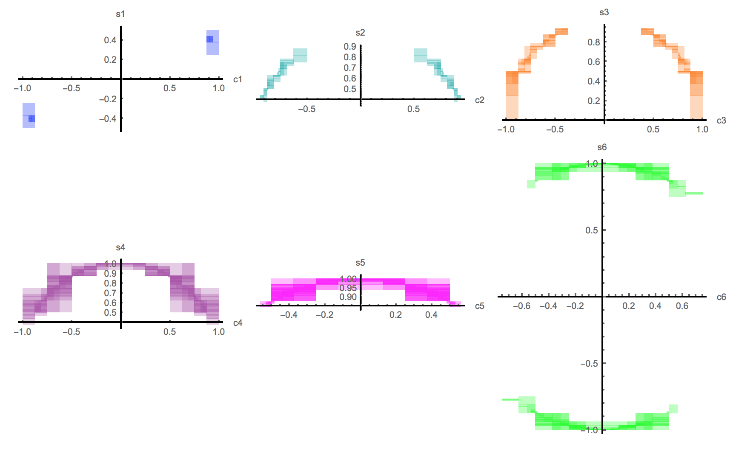
A third pass allows robot decision
Transparency helps
show 12 dimensions,
2 at a time.
Starting to look like arcs
(angle ranges).
6 million function
evaluations (a few msec)
Information increases
by a factor of 1.8×10¹¹
Remember, this is a rigorous bound of all possible solutions. Gradient-type searching with floats can only guess.
Notes:
This is looking pretty good. Those are definitely arcs of the circle, and the bifurcation into two sets of arcs is clear in four of the six graphs. The information increase is a factor of 180 billion, with only six million function evaluations. I simulated this in Mathematica and did not use parallelism or even compilation, so I did have to wait a while. That’s why I’m itching for real unum and SORNs hardware.
I bet this is sufficient for a robotic controller to make a decision about how to twist each angle in the six degrees of freedom. It can then re-assess the boundary conditions of the problem, and again solve the problem with a rigorous bound. It’s not hard to imagine a robot having plenty of low-precision unum processors that can make these decisions in real time, easily, and faster than the physical robot can actually move using motors. Low-precision iterative control is a lot closer to the way nature lets animals move, after all. When a fly lands on a wall, it does not solve the Navier-Stokes equations for computational fluid dynamics. It obviously just uses visual feedback at very low precision to converge to a muscle solution, iteratively.
You could guess using floats, too. Somehow, I feel better about powerful robots having rigorous arithmetic underlying the choices they make about their motion. We may see the day when a robotic arm kills someone because of a rounding error.

Slide 26
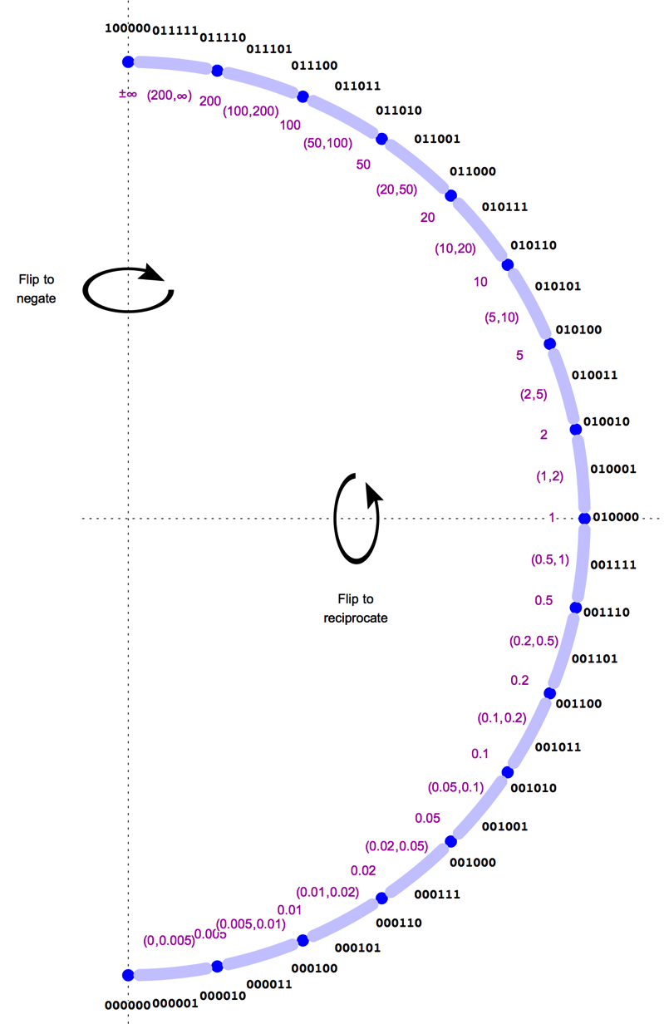
Unums 2.0
Still Universal Numbers. They are like the original unums, but:
Fixed size
Not an extension of IEEE floats
ULP size variance becomes sets
No redundant representations
No wasted bit patterns
No NaN exceptions
No penalty for using decimals!
No errors in converting human-readable format to and from machine-readable format.
An example unum set with 1, 2, 5, 10, 20,… as the “lattice”
Notes:
As I said this is like unums 2.0. They are different from the original definition in the ways listed here. The original unums adjusted their ULP sizes according to the tightest possible bounds for arithmetic results. Here we have no flexibility in the uncertainty of unums that have the ubit set to 1 (the open intervals between exact values), but instead we let the results of arithmetic consist of multiple contiguous unums, and track them with a SORN representation. Departure from IEEE floats means no more ubounds, the equivalent of interval arithmetic but with endpoints that can be open or closed. In effect, the approach described here takes us directly to “ubox” representation in one dimension, and manages the sets of uboxes automatically. Again, the idea is to eliminate the need for numerical analysis expertise.
Over on the left I’ve shown an example of what you can do with six-bit unums. To save space, I just show the positive half of the real number circle. I doubt that computer designers will ever want anything but bit strings whose length is a power of two like 4, 8, 16, 32, and 64 bits, but it’s kind of fun to see how much computing power you can get with just six bits. These are all nice decimal numbers, not binary numbers. There is no translation error incurred by entering these decimal numbers into a computer or in producing human-readable output. What you see is what you get. Computing with them is just as fast as if they were like binary floats, with a dynamic range based on powers of 2 instead of powers of 10. Right now, the decimal IEEE floats are half the speed of binary IEEE floats, and that’s if you really work at it with special-purpose hardware.
With just six bits, I can cover over four orders of magnitude and about half a decimal digit of accuracy. This is like denominations of currency, notice. We have a one dollar bill, a two dollar bill that almost no one ever uses, a five dollar bill, ten, twenty, fifty, one hundred. US currency is a little crazy in that we have a 25-cent piece instead of a 20-cent piece, but Singapore currency uses a a 20-cent piece and follows this pattern perfectly. It might make sense to use this particular unum set in an embedded application, for example. One could certainly code this up and store each number in an 8-bit byte, wasting two bits, but still getting the benefit of small tables and easy input-output.

Slide 27
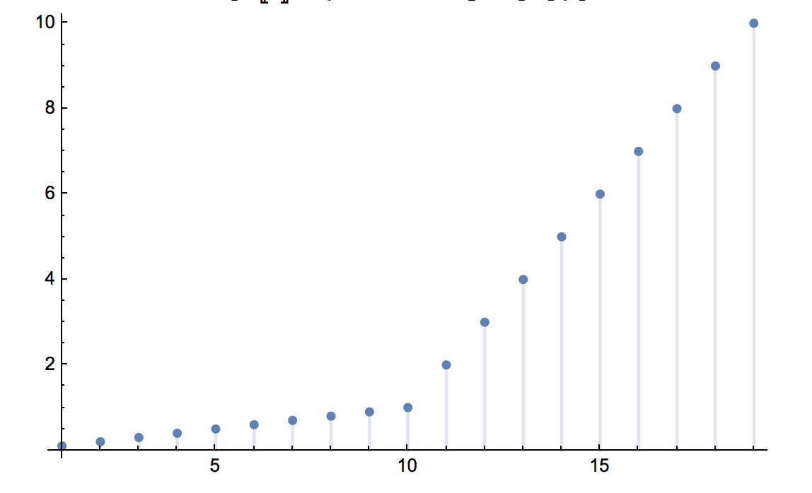
Time to get serious
What is the best possible use of an 8-bit byte for real-valued calculations?
Start with kindergarten numbers:
1, 2, 3, 4, 5, 6, 7, 8, 9, 10.
Divide by 10 to center the set about 1:
0.1, 0.2, 0.3, 0.4, 0.5, 0.6, 0.7, 0.8, 0.9,
1, 2, 3, 4, 5, 6, 7, 8, 9, 10
This has the classic problem with decimal IEEE floats: “wobbling precision.”
value
Deviations from smooth exponential lead to information loss
set member
Notes:
Let’s talk about a byte’s worth of information for each unum. We want at least one decimal of accuracy and a decent dynamic range. IBM used to use base-16 floats, that is, the dynamic range adjusted in powers of 16 instead of powers of 2. That creates surprising losses of accuracy when a number crosses into the next larger regime, because suddenly the relative inaccuracy jumps by a factor of 16. A similar problem exists for base-10 floats, as you can see here. In an ideal system, the numbers would approximate an exponential curve, since that would mean the relative accuracy was constant. The arithmetic tables would usually not “blur” as much, slowing the loss of information caused by the limited precision. Hmm…

Slide 28
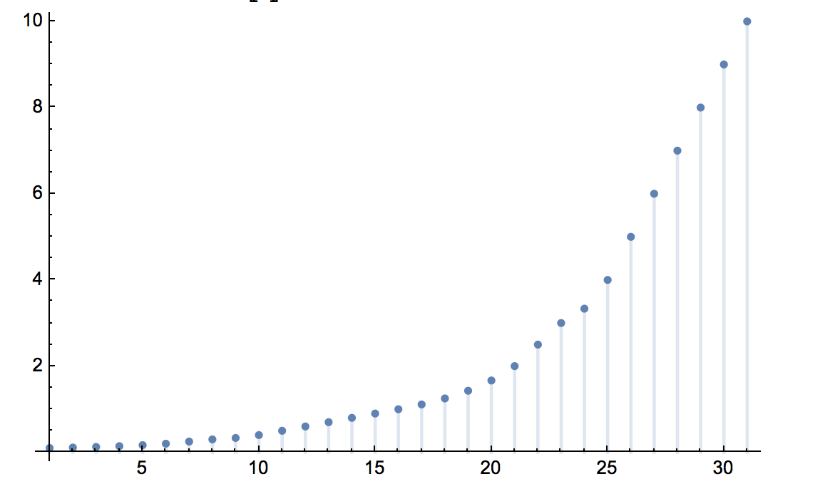
Reciprocal closure cures wobbling precision
Unite set with the reciprocals of the values, guaranteeing closure:
0.1, /9, 0.125, /7, /6, 0.2, 0.25, 0.3, /3, 0.4, 0.5, 0.6, 0.7, 0.8, 0.9,
1, /0.9, 1.25, /0.7, /0.6, 2, 2.5,
3, /0.3, 4, 5, 6, 7, 8, 9, 10
That’s 30 numbers. Room for 33 more.
value
No “kinks”!
set
member
Notes:
A pleasant surprise. We have to represent both x and 1/x as exact values for whatever set of x we pick. So reciprocate the decimals we know we want as x values in our collection, and take the union of that set with the starting set. Notice that they are not all new, because several pairs already exist as perfect reciprocals: 0.1 and 10, 0.2 and 5, 0.5 and 2, The numbers shown in orange are the new ones. Where there is a traditional way to write a reciprocal as a decimal with a finite number of digits, we do so, since we are not yet used to the unary “over” notation. Therefore, we write 0.125 instead of /8, 0.25 instead of /4, and so on. But it is easier to write /0.9 than 10/9, for example. The numbers are sorted into numerical order, and this is one of the things we have to get used to sine it’s not obvious that 0.1 is less than /9 or that /6 is less than 0.2, for example.
Some of you might be thinking, “This looks like rational arithmetic.” I see the resemblance, but it’s not rational arithmetic. With rational arithmetic, you allow numbers of the form p over q where p and q are integers represented in a traditional way. The above set does not have a lot of possible p and q values. For example, two-thirds is not part of the set. And of course there is no storage of two distinct integers.
We have space for 64 exact numbers on the positive half of the real number circle. Why 64? Because we have 256 possible bit strings in a byte, and half of those are inexact. Of the 128 exact numbers, almost half, 63, are positive; 63 are negative, and then there are the unsigned values zero and over zero. See, “over zero” is only four syllables, so it’s also a lot easier to say than “plus or minus infinity,” which is eight syllables. Maybe it will catch on.

Slide 29
/0
10¹⁰⁰
10⁵⁰
10²⁰
10¹⁰
10⁶
One approach:
“Tapered Precision” reduces relative accuracy for extreme magnitudes, allowing very large dynamic range.
10000
1000
500
200
100
80
50
40
25
20
12.5
10
9
8
7
Define the > 1 lattice points
Unite with 0
Unite with reciprocals
Unite with negatives
Unite with open intervals;
circle is complete
Populate arithmetic tables
6
5
4
/0.3
3
2.5
2
/0.6
/0.7
1.25
/0.9
1
Notes:
As explained in The End of Error, it is often desirable to have more accuracy for numbers close to 1, less accuracy for very large and very small numbers. This is the way humans use numbers. One way to do this is shown here. Call each factor of ten range a “decade”. The next decade up from 1 to 10, from 10 to 100, has fewer numbers in the lattice. The ones I picked are the ones that do not need the unary “over” notation. They all have nice traditional decimal reciprocals that do not need repeating decimals. For the decade after that, 100 to 1000, it looks like the currency-style unums: 100, 200, 500 ,1000. After that, things really grow by leaps and bounds, getting all the way to a googol, 10^{100,}, so it’s very few operations that will land you a result larger in magnitude than a googol or smaller in magnitude than over googol.
In the blue box, I show the general procedure for creating any unum-SORN number system. I have a program that does the first five steps automatically, and I am working on extending that program to automatically populate the arithmetic tables. That will permit experimentation with challenge problems, and it may even be fairly fast, certainly far faster than the original unum prototype that had many branch conditions and variable length to manage.

Slide 30
/0
Flat precision makes table generation and fused operations easier.
Imagine: custom number systems for application-specific arithmetic
100
90
80
/0.009
70
60
50
40
/0.03
30
25
20
/0.06
/0.07
12.5
/0.09
10
9
8
7
A table need only contain entries for one “decade,”
1 to 10
Power of 10 determined via integer divide, instead of having a separate bit field
6
5
4
/0.3
3
2.5
2
/0.6
/0.7
1.25
/0.9
1
Notes:
This is a little more like the way conventional floats work: each decade is self-similar, so the pattern aims for flat precision instead of tapered precision. The system provide one decimal accuracy and four orders of magnitude range, from about 0.01 to 100. With a system like this, it is much easier to figure out what decade you are in from the binary: Divide the binary (as a 2s complement integer) by the number of unums per decade, which is 30 in this case. By the way, if you have an aversion to dividing by integers other than a power of 2, since you can just shift right to divide by powers of 2, I can relate. So one thing you can do is add the square root of 10 to the lattice, which means 32 values per decade. The reciprocal of root 10, of course, is root 10 over 10. That’s an example of how an irrational number can be just another exact value in a computer number system.
Stanford has worked on “application-specific languages”. Well, consider this: we could also design application-specific number systems. Perhaps a future computer system could have a built-in default unum-SORN system that is very fast, but the option of instead defining a custom lattice and corresponding tables for arithmetic that runs somewhat slower, but gets better answers for that limited number of bits, for particular applications that make heavy use of specific numbers.

Slide 31
A very cool coincidence
Low powers of two: 1, 2, 4, 8, 16.
Low powers of five: 1, 5, 25, 125, 625.
Throw in the square root of ten, √10.
Scale to be between 1 and 10, and sort:
1, 1.25, 1.6, 2, 2.5, √10, 4, 5, 6.25, 8, 10
So what?
Why learn a weird new way
to count from 1 to 10?
Notes:
I only noticed this a few days ago, and my head is still reeling from it. I was trying to extend the “1, 2, 5, 10” system that is commonly used for currency, and I started adding 2 squared and 5 squared so that 4 and 2.5 are in the vocabulary. I kept going a little further and watching how it populated the set of values that can be scaled to lie between 1 and 10. When I got up to 2 to the fourth and 5 to the fourth, and I threw in the square root of ten, I discovered something inexplicable and mind-blowing about this weird new way to count from 1 to 10, which I need to show you with a graph.

Slide 32
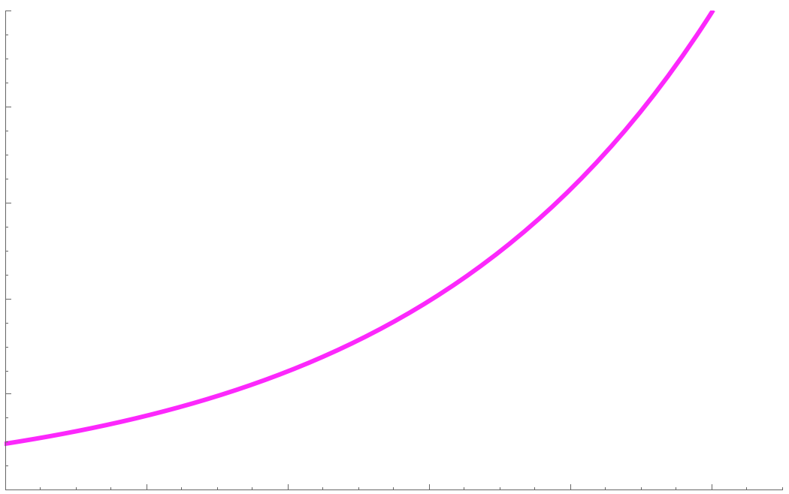
10
10
Represented value
9
10
Perfect exponential curve;
relative precision is absolutely flat.
1 decibel = 10^{1/10} = 1.26…
8
8
7
6.25
7.94…
6
5
6.31…
5
4
5.01…
4
√10
3
3.98…
2.5
2
√10
2
1.6
2.51…
1
1.25
2.00…
1
1.58…
1
1.26…
0
0
1
2
3
4
5
6
7
8
9
10
lattice point, counting up from zero
Notes:
The ideal representation would have no “wobbling precision.” The relative accuracy would be the same for every value, which only happens with a perfectly exponential curve like 2^{x} or e^{x} or 10^{x}. Binary floats wobble near integer powers of two, where the slope changes. Decimal floats wobble even worse, because near powers of ten, their spacing changes by a factor of ten. That results in lost information. So the amazing coincidence is that the numbers I just showed you form almost exactly an exponential scale, so close that you can’t even see the difference at this scale.
If you are familiar with decibels, “1 dB” is ten to the one-tenth power, which is about 1.26. If you keep increasing by that ratio ten times, you get a factor of ten. The decibel values are indicated in magenta, to three decimal places. The match is incredibly close. This reminds me of another mathematical coincidence…

Slide 33
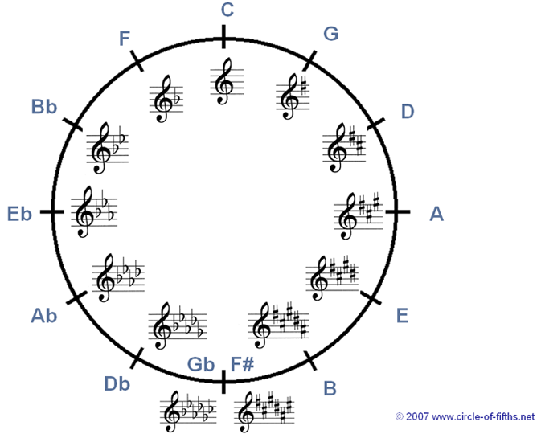
Like the “circle of fifths” in music
Made possible by another
logarithmic coincidence.
Interval of an octave is 2:1
Interval of a fifth is 3:2
Go up a fifth, twelve times. What is the ratio?
1.5¹² is almost exactly seven octaves!
The equal-tempered scale is logarithmic, yet closely approximates the ratio of small integer ratios.
Notes:
The basis for all Western music, the 12-note scale. If a pitch rises by the musical interval of a fifth, that’s a frequency ratio of 3 to 2. If you go up an octave, the frequency doubles. As Pythagoras observed, frequency ratios of small integers sound musically consonant to our ears. The coincidence is that if you rise by a fifth, twelve times, you land on a note seven octaves up from where you started, almost exactly. So “equal temperament” tuning stretches the fifths ever so slightly to make the coincidence exact, and along the way creates a set of notes that have ratios very close to the ratios of small integers. It’s another example of a nearly perfect logarithmic scale, but this one covers a ratio from 1 to 2 instead of from 1 to 10.

Slide 34
Non-negative exact values
0, 0.0008,
0.001, 0.00125, 0.0016, 0.002, 0.0025,
0.001√10, 0.004, 0.005, 0.00625, 0.008,
0.01, 0.0125, 0.016, 0.02, 0.025,
0.01√10, 0.04, 0.05, 0.0625, 0.08,
0.1, 0.125, 0.16, 0,2 , 0.25,
0.1√10, 0.4, 0.5, 0.625, 0.8,
1, 1.25, 1.6, 2 , 2.5,
√10, 4, 5, 6.25, 8,
10, 12.5, 16, 20 , 25,
10√10, 40, 50, 62.5, 80,
100, 125, 160, 200, 250,
100√10, 400, 500, 625, 800, 1000,
1250, /0
With negatives and open ranges, 256 values (1 byte)
Over six orders of magnitude
Only one digit precision, but the precision is flat
Exact decimals, except for √10. (If you don’t like it, ignore it)
Notes:
Here are the positive decimal unum 2.0 values for the “well-tempered” 8-bit system. If you combine these numbers with their negatives, and then with the spaces between values, you have exactly 256 distinct values. It’s a very honest single decimal of accuracy, with a strikingly large six orders of magnitude dynamic range. Think it looks useless? You’d be surprised what you can do with one decimal accuracy and six orders of magnitude, at least as a first approximation to an answer. And if you can do it with only 8-bit numbers (bytes), imagine how fast existing processors would be at the data manipulations. It’s already built in to modern processors; we just have to populate the look-up tables.
I know the square root of ten is an ugly thing to have in there. If you don’t like it, just leave it out. The computer can use it internally to improve answers, but it does not have to be part of standard input and output.

Slide 35
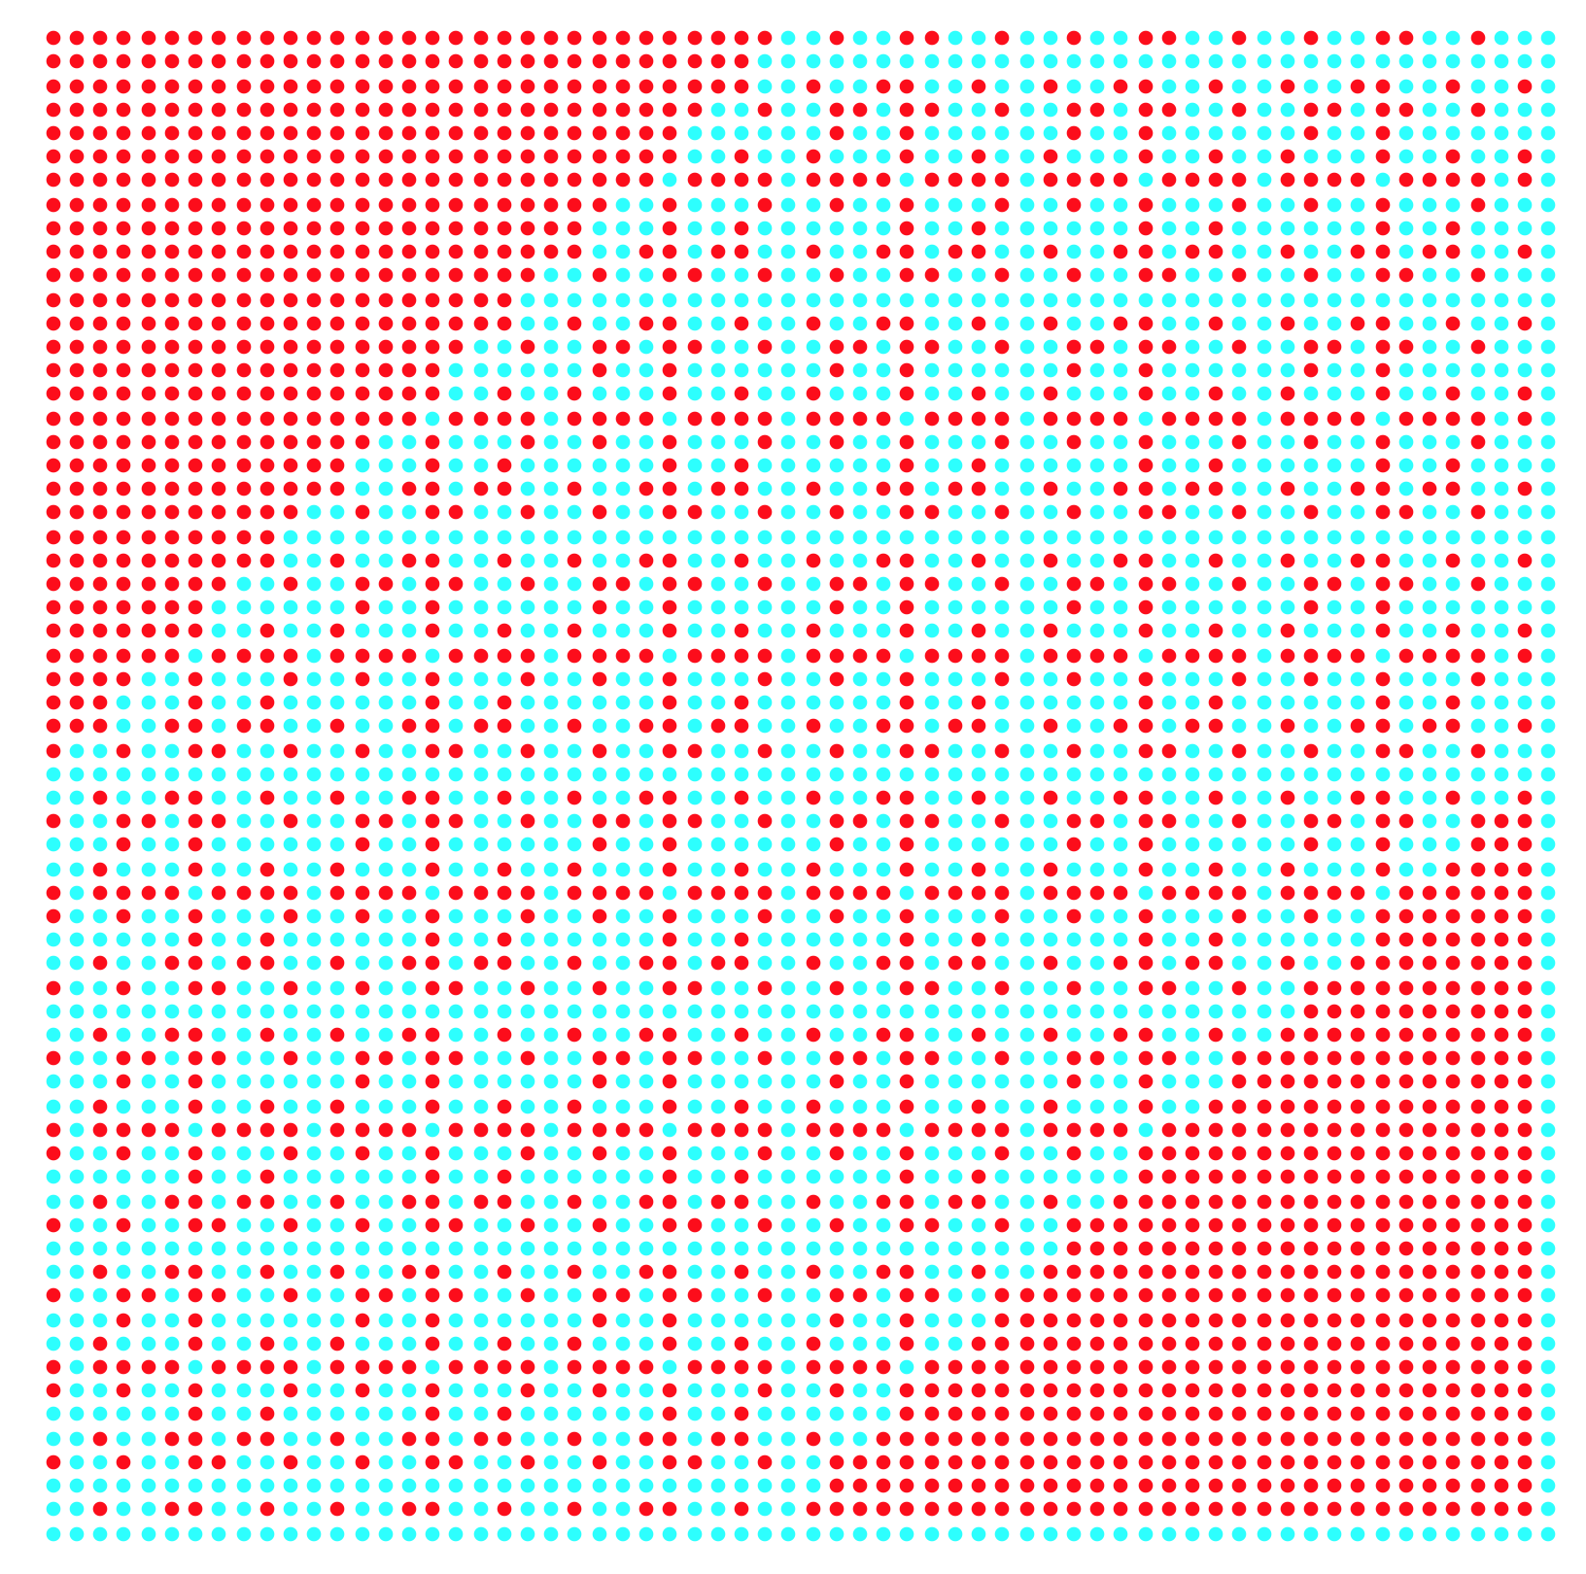
Closure plot for multiply, divide
l = Exact result
l = Inexact
(single ULP range)
Embedded l are where the power of 2 and the power of 5 differ by more than 4.
Notes:
Looks like a quilt. I like to use “closure plots” to see how well standard operations perform for a given lattice of exact values. Ideally, the result of any operation on two exact values would be another exact value. That does not happen very often with floats. The places where it happens are shown with cyan dots here; red dots mean the answer lies between two exact values, so information has been lost.
Just look at how often the dots are cyan! I suppose I should have shown the float closure plot first so you would be more impressed, but it is pretty amazing that so many products (and quotients, which are the same thing in this system) land on exact values. That means we can multiply and divide many numbers without incurring any information loss. A hand-crafted representation with a small number of bits can actually be more useful and meaningful than bit strings that are many times larger.

Slide 36
8-bit unum means 256-bit SORN
±∞
–1
0
1
(maxreal, ∞)
unums:
10000000
…
11000000
…
00000000
…
01000000
…
11111111
SORN:
…
…
…
…
64 bits
64 bits
64 bits
64 bits
Ultra-fast parallel arithmetic on arbitrary subsets
of the real number line.
Ops can still finish within a single clock cycle,
with a tractable number of parallel OR gates.
Notes:
Remember that if the unum has n bits, the SORN has 2^{n} bits. So a byte-size unum results in a 256-bit SORN, and this is starting to look like a real explosion in the storage requirements. It is clear that the approach described up to this point looks very promising up to some precision, but we do not yet know where the SORN and the table-lookup approach become intractable. This is ongoing research, but there are some promising ways to deal with that apparent explosion in storage demand.
At 256 bits, an arbitrary SORN still only takes the space of four double-precision numbers. That does not seem to be a terrible price to pay for the ability to operate on subsets of the entire real number line, quite possibly in a single clock cycle if you build the circuitry for all of those OR operations and table look-ups. it should not take much chip area or electrical power. The next slide shows how we can radically reduce the size of SORN storage.

Slide 37
Only need 16-bit SORN for + – × ÷ ops
Connected sets remain connected under + – × ÷ , even division by zero!
Run-length encoding of a contiguous block of 1s amongst 256 bits only takes 16 bits.
00000000 00000000 means all 256 bits are 0s
xxxxxxxx 00000000 means all 256 bits are 1s (if any x is nonzero)
00000010 00000110 means there is a block of 2 1s starting at position 6
2
6
Trivial logic still serves to negate and reciprocate compressed form of value.
Notes:
If you start with traditional intervals, then plus-minus-times operations always produce intervals. Divide, always the bad boy, does not behave that way. If you divide 1 by the interval [–1, 1], you get two intervals: [–∞, –1] and [1, ∞] because you’re dividing by zero and that sends you to the left extreme and right extreme part of the real number line.
But wait, we don’t have a real number line. We have a real number circle. Those two intervals are actually joined at /0. Connected sets stay connected under this number system!
That means that the four arithmetic operations will always take input values, exact or inexact, into connected sets. If each unum is n bits, the SORN for a contiguous block of 1s takes less than 2n bits. Without going into details here, it’s not a difficult system to learn or program. All zero bits means the SORN is all zero bits. All one bits means the SORN is all one bits. Otherwise, the first n bits says how many 1s in a row there are, and the second n bits is the position where the run of 1s starts, wrapping around to the beginning of the SORN if it goes off the end.
Here’s the thing: A computing environment could very easily set a tolerance level for the number of 1s in a row. That indicates how much information has been lost through loss of information. Since some of the indeterminate forms like infinity minus infinity light up the entire real number circle, that will trip the “time to give up!” trigger if there is a tolerance level set… the SORN will have nothing but 1s in it.
I don’t have time to go into detail here, but notice that every arithmetic operation consumes pairs of values that are either exact or just one “ULP” wide, that is, a single open interval between as-close-as-possible exact values. The fuzziness of the computation expands linearly in general, with the fuzz contributed by the outer edges of the contiguous range of values. That is the massive difference between unum arithmetic and interval arithmetic; interval arithmetic operations on inputs that keep getting larger, so the size of the containment grows exponentially, producing ridiculously pessimistic results. The IEEE-compatible unums deal with this problem via uboxes that subdivide ranges of numbers. Unums 2.0 automate the process by having a fixed lattice and a SORN that says how many unums are in the SORN. This is why we are finally within striking distance of being able to make accuracy control the responsibility of the computer, not the programmer, and without invoking symbolic mathematics or extended-precision libraries.

Slide 38
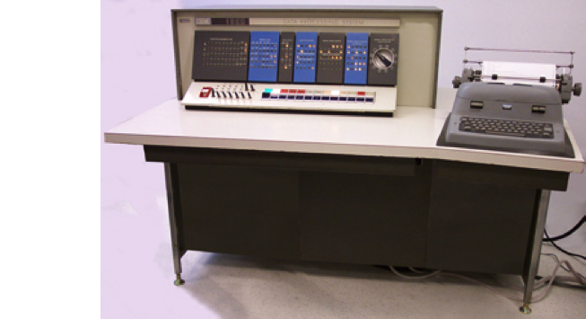
Table look-up background
In 1959, IBM introduced its 1620 Model 1 computer, internal nickname “CADET.”
All math was by table look-up.
Customers decided CADET stood for “Can’t Add, Doesn’t Even Try.”
Notes:
I remember being six or seven years old when my father told me about the CADET computer and what the name stood for, and I remember laughing pretty hard. Cute machine, isn’t it? I especially like that dial on the right, just to the left of the printer output. I wonder what you dialed up and down?
It could handle binary or decimal representations, and decimal representations used table look-up. Why did IBM make that choice?
First of all, transistors were awfully expensive in 1959. A single transistor was more expensive than a tire for a car, to give you something that sort of adjusts for inflation all the way to 2016. Table look-up certainly saves transistors compared to doing all the calculations with Boolean logic, at least up to some precision. By the way, David Kahaner tells me he actually used this machine, and that you had to load the tables when you turned it on. If you forgot to load the tables, all you got was garbage. Strange that they did not hard-wire them.
Chips still use a lot of table memory, but they use it for other things like microcode. A very big part of the real estate of every modern Intel chip is the microcode to emulate most of the instructions, where only the most commonly-used instructions are native to the circuitry. How many bits of table memory can we put on a chip these days? As Sagan would say, “Billions and billions!” though he denied ever saying that phrase.
Is it time to reconsider table lookup for arithmetic, at least up to some precision?

Slide 39
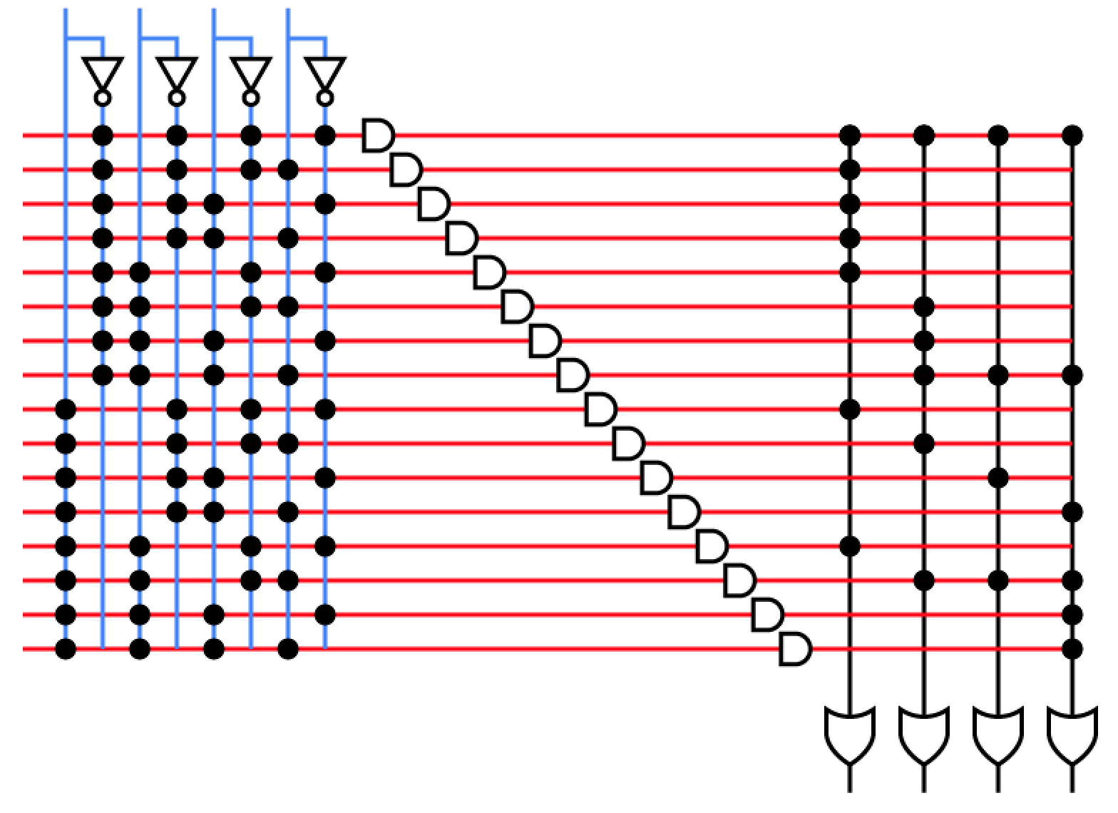
Table look-up requires ROM
Read-Only Memory needs very few transistors. ~3x denser than DRAM, ~14x denser than SRAM.
Billions of ROM bits per chip is easy.
Imagine the speed… all operations take 1 clock! Even x^{y}.
1-op-per clock architectures are much easier to build.
Single argument-operations require tiny tables. Trig, exp, you name it.
x unum
y unum
88 CMOS transistors for ROM
versus 280 for DRAM,
1,240 for SRAM
SORN for x + y
Low-precision rigorous math is possible at 100x the speed of sloppy IEEE floats.
Notes:
Compared to RAM, and compared to Boolean logic for arithmetic, ROM is really simple. The diagram shows that you only really have three gate delays to go from input to output; gate delays are measured in picoseconds these days. It takes dozens of gate delays, a lot of them in parallel, to perform even a half-precision IEEE float operation. I’m just estimating the 100x speed increase; obviously, we have to build something and measure it before we can back up that claim. But as someone who has programmed math libraries, I can tell you that a single-clock execution time for x to the y power is pretty mind-blowing. Even more compelling is the ability to table the single-operand functions like logarithm, exponential, sine, cosine, tangent, and so on. Or even the arc hyperbolic cosecant, or Bessel functions. They take hardly any space because they are one-dimensional tables! Imagine vast math libraries, all computed to ultimate accuracy, on tap and not subject to “The Table-Makers Dilemma” of unpredictable execution time, or an unpredictable number of ULPs of rounding error.
Fewer transistors per operation means smaller circuits, which means faster circuits since we are speed-of-light limited now. It also means less power consumption. Those two things together means more copies of processors can exist on a given area of silicon, increasing parallel computing power.

Slide 40
Cost of + – × ÷ tables (naïve)
Addition table: 256×256 entries, 2-byte entries = 128 kbytes
Symmetry cuts that in half, if we sort x and y inputs so x ≤ y. Other economizations are easy to find.
Subtraction table: just reflect the addition table
Multiplication table: same size as addition table
Division table: just reflect the multiplication table!
Estimated chip cost: < 0.01 mm², < 1 milliwatts
128 kbytes total for all four basic ops.
Another 64 kbytes if we also table x^{y}.
Notes:
Suppose we did the brain-dead thing of just populating the entire addition table for 256 possible x and 256 possible y values. With the 2-byte compressed form of the SORN, that would take 128 kilobytes. But if we just store the part of the table for x less than y, since addition is commutative, we can cut that very nearly in half. Subtraction table? Just use the addition table using negative y, which you may recall is very easy to compute with 2s complement bit-flips. So about 64 kilobytes suffices for addition and subtraction.
The multiplication table is like the addition table, symmetric because x times y is the same as y times x. The division table? Just use the multiplication table with over y, just as easy to compute with the 2s complement integers. Therefore, 64 kilobytes of table also provides multiplication and division, for a grand total of 128 kilobytes for the four arithmetic operations.
The power function x to the y does not have symmetry, so we need another 128 kilobytes to hold all those entries.
Most of the bits in the table are simple wired connections between metal layers, so this is a very dense table compared to RAM or logic circuits. I estimate it would take less than one-hundredth of a square millimeter and consume less than a milliwatt even when driven hard. If I’m right, you will probably want quite a few of these tables on the chip.
By the way, single-argument tables just take 512 bytes each! Get out your Handbook of Mathematical Functions, because you could put just about every imaginable special function anyone has ever thought up into the tables, just as people used to use math tables in reference books to do tough computations.

Slide 41
What about, you know, decent precision? Is 3 decimals enough?
IEEE half-precision (16 bits) has ~3 decimal accuracy
9 orders of magnitude, 6×10^{–5} to 6×10⁴.
Many bit patterns wasted on NaN, negative zero, etc.
Can a 16-bit unum do better, and actually express decimals exactly?
1000000000000000
65536 bit patterns. 8192 in the “lattice”.
Start with set = {1.00,1.01, 1.02,…, 9.99}.
Unite with reciprocals.
While set size < 16384:
unite with 10× set.
Clip to 16384 elements centered at 1.00
Unite with negatives.
Unite with open intervals between exacts.
What is the dynamic range?
/0
1100000000000000
–1
+1
0100000000000000
0
0000000000000000
Notes:
For so many applications, the user seeks only three or four correct digits of output , and the reason for using 15-digit double precision for the calculation is just over-insurance against rounding errors of an unknown, un-analyzed nature. If you had rock-solid math good to three decimals, and real decimals instead of binary substitutes, maybe you would discover that 16-bit unum data types could be sufficient or even superior to half-precision IEEE floats, for many workloads.
By the way, there is no IEEE standard for 16-bit decimal floats, only 32-bit, 64-bit, and 128-bit decimal floats. Apparently they took a look at how the IEEE Standard would work for such low-precision decimals and realized it was so awful that they would be better off not even trying. The mathematically unsound parts of the standard become especially conspicuous as precision is reduced.
Unum representation has more to do than floats, though. It has to keep all those reciprocals, and it has to store the open intervals between exact numbers, not just the exact numbers. That will suck up a lot of bit patterns that IEEE floats do not have to spend. On the other hand, IEEE floats waste lots of bit patterns on NaN and ways to represent zero (especially if they do not support gradual underflow, which is typical for graphics chip implementations of 16-bit floats). That makes us suspect that the extra mathematical power of unums will come at the cost of reduced dynamic range, since you won’t be able to store as many decades in the 2s complement integer form. Let’s see what the penalty is.

Slide 42
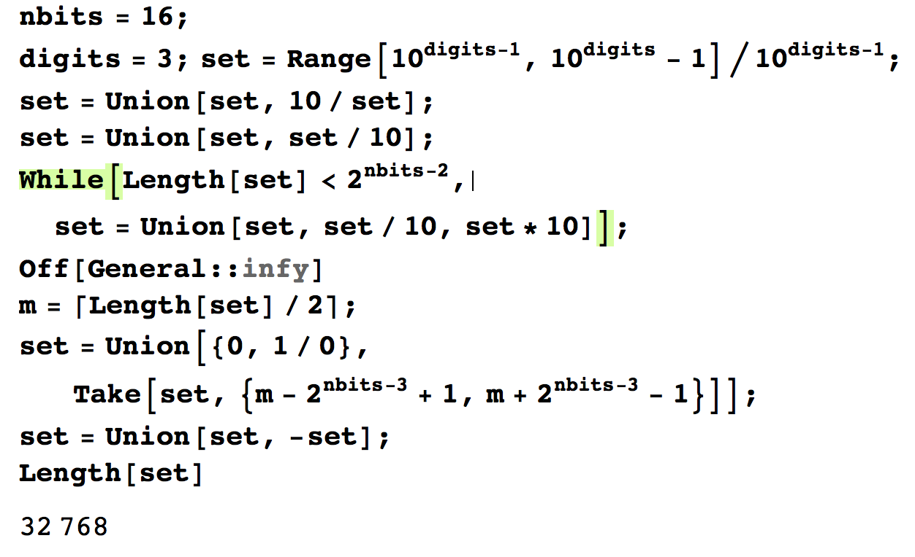
Answer: 9⁺ orders of magnitude
/0.389×10^{–5} to 0.389×10⁵
This is 1.5 times larger than the range for IEEE half-precision floats.
This is the Mathematica code for generating the number system.
Notice: no “gradual underflow” issues to deal with. No subnormal numbers.
Notes:
Whoa. That was not expected. Unums actually have a larger dynamic range than floats with the same number of bits, on top of having perfect reciprocals and tracking of both exact and inexact values! And exact representation of decimals.
As I usually do when I suspect people won’t believe me, I supply the Mathematica code to reproduce the result.
Hardware designers hate gradual underflow because it adds almost thirty percent to the silicon area needed for the floating-point math. Subnormal numbers are such a hotly contested part of the IEEE standard that they are a “recommendation” of the standard, not a requirement. Or is it an “option” of the standard? The standard has requirements, recommendations, and options, which is why it’s not really a standard at all since various designs can all be IEEE compliant yet produce many different wrong answers instead of a single, repeatable wrong answer. Notice that there are no gradual underflow unum numbers in the system described here. There is also no way two computers could get different answers unless at least one of them is broken, any more than integer calculations could produce different answers.

Slide 43
IEEE Intervals vs. SORNs
Interval arithmetic with IEEE 16-bit floats takes 32 bits
  Only 9 orders of magnitude dynamic range
  NaN exceptions, no way to express empty set
  Requires rare expertise to use; nonstandard methods
  Uncertainty grows exponentially in general (or worse)
SORN arithmetic with connected sets takes 32 bits
  Over 9 orders of magnitude dynamic range
  No indeterminate forms; closed under + – × ÷
  Automatic control of information loss
  Uncertainty grows linearly in general
Notes:
We can almost compare apples with apples by comparing traditional interval arithmetic, using 16-bit floats, with SORNs restricted to connected sets so that they can be stored in only 32 bits. They both take 32 bits and they both use techniques to rigorously contain the correct mathematical result. SORNs win on every count.
Besides the advantages of unums listed here, perhaps it deserves mention that the SORNs store decimal numbers whereas the IEEE 16-bit floats are binary and in general make rounding errors converting to and from human-readable form. Also, there are many problems that traditional intervals cannot solve because all their intervals are closed at both endpoints. Sometimes it is crucial to know whether the exact endpoint is included, or just approached. You cannot do proper set operations with traditional intervals. Like, if you ask for the set of strictly positive real numbers, you get [0, ∞] which incorrectly includes zero (not strictly positive) and infinity (not a real number). If you ask for the complement of that set, well, the best you can do is [–∞, 0]. How can it be the complement if both sets contain the same number, zero? The mathematical rigor claimed for traditional interval arithmetic is actually couched in lots of “gotcha” exceptions that make it even more treacherous to use than floats. Which is why people stick with floats instead of migrating to intervals.

Slide 44
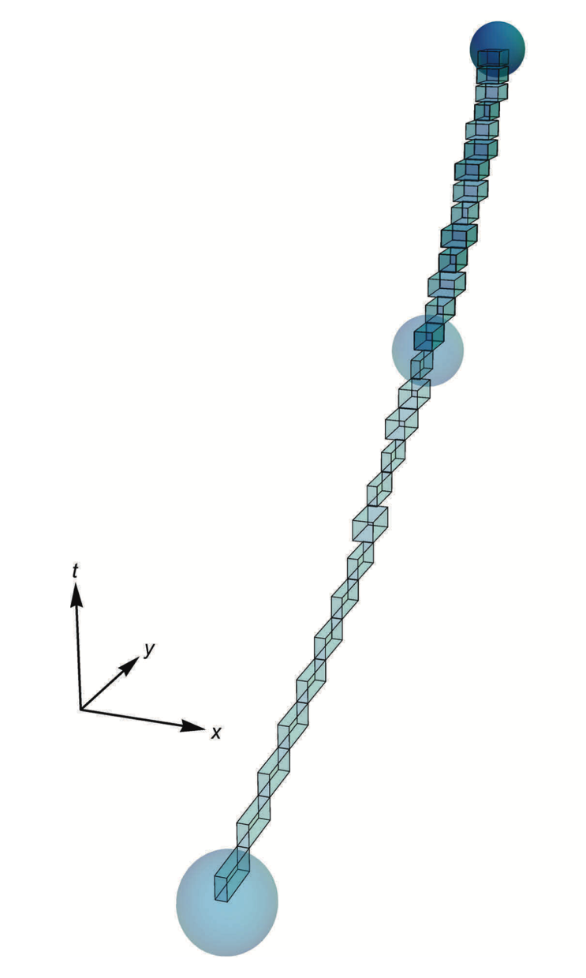
Why unums don’t have the interval arithmetic problem
Unum n-body calculation
shows slow, linear expansion of bound.
Intervals cannot
do this.
Intervals: Each step starts from the interval produced in the previous step.
⇒ Bounds grow exponentially
Unums: Each stage of a calculation starts with values that are either exact or one ULP wide, and then takes the union of the results.
⇒ Bounds grow linearly.
Notes:
An “ULP” is a Unit in the Last Place, or a Unit of Least Precision. It’s the spacing between exact numbers. When you use interval arithmetic, the interval can approximately double with each step of the calculation, since calculations require the worst-case of combinations of the smallest and largest numbers in the previous calculation.
With unums, and this is true for both 1.0 and 2.0 versions of unums, the worst thing that can happen to each exact value is that it lands in an ULP, and the worst thing that usually happens to any ULP-wide uncertainty is that it becomes two ULPs wide. But with unums, you always start out with a set of exact or single-ULP values, and they can only “blur” a little bit, so the union of all those blurs only grows linearly. Like fraying at the edges. That is far preferable to exponentially expanding bounds that become so large as to be useless. What I’ve shown here is an actual unum calculation of an n-body orbital trajectory, and look how tight the bound is. If you tried this with interval arithmetic, you’d get a horn-shaped expansion of the size of those little hexahedrons, and they quickly become so large that you have to stop the calculation as having become meaningless (unbounded).

Slide 45
“Dependency Problem” ruins interval arithmetic results
“Let x = [2, 4]. Repeat several times: x ← x – x; Print x.”
Intervals (128 bits):
[–2, 2]
[–4, 4]
[–8, 8]
[–16, 16]
[–32, 32]
[–64, 64]
[–128, 128]
Unstable. The uncertainty
feeds on itself, so interval
widths grow exponentially.
SORNs (8-bit unums):
(–1, 1)
(–0.2, 0.2)
(–0.04, 0.04)
(–0.01, 0.01)
(–0.002, 0.002)
(–0.0004, 0.0004)
(–0.0008, 0.0008)
Stable. Converges to the
smallest open interval
containing zero.
Notes:
A lot of people try out interval arithmetic, usually just once. Because it exhibits the behavior shown here, where the bounds on an answer grow wildly, exponentially, The width of input intervals gets compounded, so the uncertainty feeds on itself. Interval advocates have proposed lots of tricks to avoid this, like “Rewrite your problem so that each variable only appears once,” and “Use affine arithmetic” and other things that require a lot of human effort and expertise to use… and don’t always help the problem.
With SORNS, the interval [2, 4] gets represented as set of unums. With the 8-bit unums defined a few slides back, it would be the set {2, (2, 2.5), 2.5, (2.5, r10), r10, (r10, 4), 4. Each unum is subtracted only from itself, not from every other unum, and then the results are OR’ed together. That result is a collection of unums near zero, between –1 and 1. The widest “ULP” in that range is that of inexact unums (0.8, 1) or (–1, –0.8), The next subtraction thus results in the smaller range (–0.2, 0.2). Not only is it not growing exponentially, it’s actually shrinking. It keeps shrinking all the way to the smallest open interval containing zero, the one that ranges from –smallnum to smallnum. That is, it is a SORN with only three presence bits set.

Slide 46
Another classic example of
“the Dependency Problem”
“Let x = [2, 4]. Repeat several times: x ← x / x; Print x.”
Intervals:
[1/2, 2]
[1/4, 4]
[1/16, 16]
[1/256, 256]
[1/65536, 65536]
⋮
Unstable. Again, the
interval widths grow
very rapidly.
SORNs (8-bit unums):
(0.625, 1.6)
(0.625, 1.6)
(0.625, 1.6)
(0.625, 1.6)
(0.625, 1.6)
⋮
Stable. Contains the
correct value, 1, despite
only single-digit accuracy
Notes:
This shows another common example of the dependency problem. When you divide x by itself, interval arithmetic takes all possible combinations of the largest and smallest point in x divided by the largest and smallest point in x. So, instead of getting 1, we get a minimum of 2 divided by 4, ½, and a maximum of 4 divided by 2, 2. When we repeat the process, it squares the left and right endpoint each time, growing super-exponentially!
In contrast, the SORN solution is a cluster of values near 1, and because we are only working with very low-accuracy unums the bound is very approximate. But it’s stable.
This is the power of always starting an arithmetic operation with the same set of small ranges or exact real numbers, instead of allowing uncertainty to feed on itself and explode to infinity. And remember, the multiple table-based evaluations of presence bit combinations are fast and data parallel.

Slide 47
Why it works
x is [1/2, 2]
/0
–1
0
0.5
1
2
(1250, /0)
…
…
Divide x by x, for each unum
whose presence bit is set.
(Ideally, do these in parallel.)
Compiler
sets the
hardware
mode to
“dependent”
so all table
look-ups are
reflexive,
not all-to-all.
0.5 / 0.5
= 1
(0.5, 0.625) / (0.5, 0.625)
= (0.8, 1.25)
0.625 / 0.625
= 1
(0.625, 0.8) / (0.625, 0.8)
= (0.78125, 1.28)➧(0.625, 1.6)
0.8 / 0.8
= 1
(0.8, 1) / (0.8, 1)
= (0.8, 1.25)
1 / 1
= 1
(1, 1.25) / (1, 1.25)
= (0.8, 1.25)
1.25 / 1.25
= 1
(1.25, 1.6) / (1.25, 1.6)
= (0.78125, 1.28)➧(0.625, 1.6)
1.6 / 1.6
= 1
(1.6, 2) / (1.6, 2)
= (0.8, 1.25)
2 / 2
= 1
OR the SORN bits to form the union:
= (0.625, 1.6)
Notes:
Just to walk through that last example… with 8-bit unums, the SORN for the interval [1/2, 2] has thirteen presence bits set. Each unum is divided by itself using the division look-up table. When the unum is exact, the resulting SORN simply has the exact value 1. For a range like (0.5, 0.625) there is a little bit of interval-type expansion, but confined to one ULP, so the resulting SORN is the three unums (0.8, 1), 1, and (1, 1.25).
Notice the case (0.625, 0.8) divided by itself; the endpoints of the resulting range do not land on u-lattice points, so we have a little additional information loss. All these effects are exaggerated because we are using only 8-bit precision, of course. If we went to 16-bit precision unums, still quite modest compared to typical floats, the uncertainty expansion would be in parts per thousand and too small to depict visually.
All of those SORNs can be computed in parallel; the OR of all the bits then forms the union, which is the worst-case range of (0.625, 1.6).

Slide 48
Future Directions
Create 32-bit and 64-bit unums with new approach; table look-up still practical?
Compare with IEEE single and double
General SORNs need run-length encoding.
Build C, D, Julia, Python versions of the arithmetic
Test on various workloads, like
  Deep learning
  N-body
  Ray tracing
  FFTs
  Linear algebra done right (complete answer, not sample answer)
  Other large dynamics problems
Notes:
The prototypes of this type of unum math look promising up to 16 bits, as described here. Once the precision gets up to 32-bit and 64-bit, an arbitrary SORN will have to be stored with some form of run-length encoding. That means a SORN that allows representation of disconnected sets will have variable storage. Maybe it’s worth it, but it is pretty clear we do not want to store a SORN with 4 billion bits. The single-precision contiguous SORN requires 64 bits in general. The table look-up gets big, but you need only store the table for one decade, and handle the exponent separately as is done with floats. I’ve listed some workloads that I think would be good tests. William Kahan has suggested that the best acid test is to simulate the orbit of Halley’s Comet, with just the sun and the gas giant planets in the n-body problem. The uncertainty, he says, becomes severe with traditional interval arithmetic, and it is easy to see how that can happen. Can unums do better? We will find out once we get an implementation that is both fast and high-precision.

Slide 49
Summary
A complete break from IEEE floats may be worth the disruption.
Makes every bit count, saving
storage/bandwidth,
energy/power
Mathematically superior in every
way, as sound as integers
Rigor without the overly pessimistic bounds of interval arithmetic
/0
–1
1
0
This is a path beyond exascale.
Notes:
I started this work over thirty years ago, trying to fix not just floating point arithmetic but also figure out and repair, if possible, the flawed alternatives that have been proposed (like interval arithmetic). The work got a big boost when it became clear that the biggest obstacle to exascale computing was electrical power, and the biggest part of power consumption was moving data to and from DRAM instead of on-chip operations. Company executives always care about power consumption, and very few company executives care about correct answers since they do not hear complaints about incorrect answers. I admit that I smuggle mathematical correctness into the computing business inside of a Trojan horse of energy and power savings. For the longest time, there has been a tradeoff between getting high-quality answers and running fast. I think you can have it both ways. Not only that, I think unum arithmetic can get us to commodity exascale computations sooner than floats can get us to commodity exascale. It’s a shortcut, though a new chip technology (ROM-intensive) usually takes many years to fire up. All we have to do is agree to a complete break from traditional, bit-parceled IEEE format, and we can get there.

