Slide 1
AN ENERGY-EFFICIENT AND MASSIVELY PARALLEL APPROACH TO VALID NUMERICS
John L. Gustafson
ICRAR Seminar
john.gustafson@nus.sg.edu
2 June 2016

Slide 2
Why ask for 10¹⁸ flops per second?
Henry Ford once said, “If I had asked my customers what they wanted, they would have said they wanted a faster horse.”
That is what we are doing now with supercomputing: asking for a faster horse, not what comes after horses.
We do not need 10¹⁸ sloppy operations per second that produce rounding errors of unknown size; we need a new foundation for computer arithmetic.

Slide 3
Big problems facing computing
Too much energy and power needed per calculation
More hardware parallelism than we know how to use
Not enough bandwidth (the “memory wall”)
Rounding errors more treacherous than people realize
Rounding errors prevent use of parallel methods
Sampling errors turn physics simulations into guesswork
Numerical methods are hard to use, require experts
IEEE floats give different answers on different platforms

Slide 4
The ones vendors care most about
Too much energy and power needed per calculation
More hardware parallelism than we know how to use
Not enough bandwidth (the “memory wall”)
Rounding errors more treacherous than people realize
Rounding errors prevent use of parallel methods
Sampling errors turn physics simulations into guesswork
Numerical methods are hard to use, require experts
IEEE floats give different answers on different platforms

Slide 5
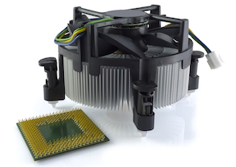
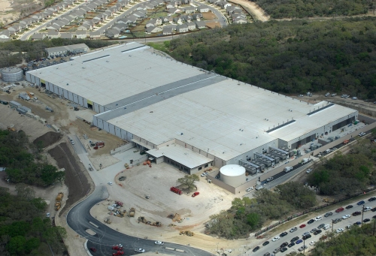
Too much power and heat needed
Huge heat sinks
20 MW limit for exascale
Data center electric bills
Mobile device battery life
Heat intensity means bulk
Bulk increases latency
Latency limits speed
Notes:
Whether it’s the battery life of a cell phone or a data center pushing the limits of how many megawatts it can draw from the local substation, power is now the biggest limit computer designers face. So what exactly in the computer is burning up most of the power?

Slide 6
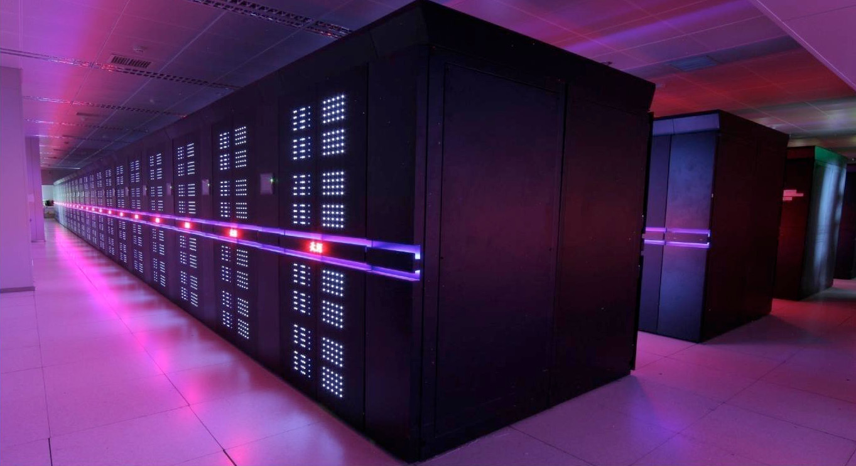
More parallel hardware than we can use
Huge clusters usually partitioned into 10s, 100s of cores
Few algorithms exploit millions of cores except LINPACK
Capacity is not a substitute for capability!

Slide 7
Not enough bandwidth (“Memory wall”)
Operation | Energy consumed | Time needed
64-bit multiply-add | 200 pJ | 1 nsec
Read 64 bits from cache | 800 pJ | 3 nsec
Move 64 bits across chip | 2000 pJ | 5 nsec
Execute an instruction | 7500 pJ | 1 nsec
Read 64 bits from DRAM | 12000 pJ | 70 nsec
Notice that 12000 pJ at 3 GHz = 36 watts!
One-size-fits-all overkill 64-bit precision wastes energy, storage, bandwidth
Notes:
The surprise is, not the transistors! It’s the WIRES. Communication is now almost all of the parts cost, almost all of the time spent, and almost all of the energy and power consumed! If you swapped very transistor in a current computer for some new magical kind of switching device, like a carbon nanotube transistor, and if it used zero energy and went infinitely fast and didn’t cost anything, you would only improve the computer by a few percent. So the place I started looking for savings was this: For all the bits we move back and forth, how many of them are really necessary? Which brings up…

Slide 8
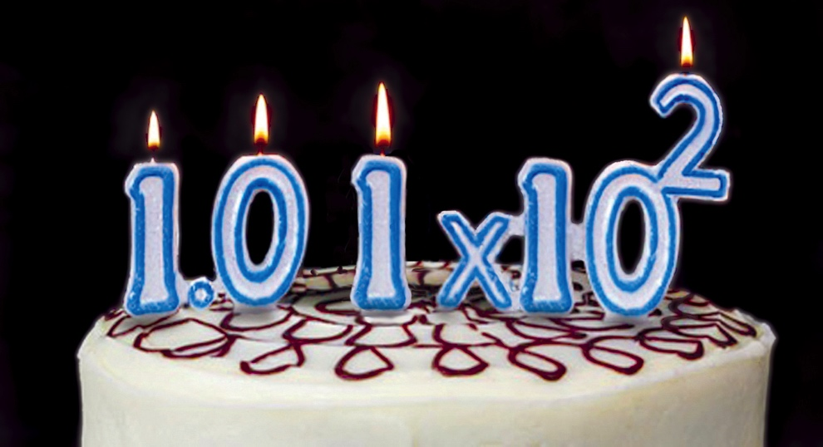
Happy 101th Birthday, Floating Point
1914: Torres y Quevedo proposes automatic computing with fraction & exponent.
2015: We still use a format designed for World War I hardware capabilities.
Notes:
Having the computer keep track of the scale factor, and being able to express very large and very small numbers, certainly was a huge step forward from only being able to compute with counting numbers. It takes major programming effort to compute with “fixed point” or integer arithmetic, because arithmetic is always overflowing or underflowing. By the way, the computer in the picture is the source of a popular myth that Thomas J. Watson said “I think there is perhaps a market for five computers in the world”. What he actually said to a stockholders meeting was that they did a sales tour for the IBM 701 to twenty customers, expecting perhaps five of them to order one, and actually got orders for eighteen.

Slide 9
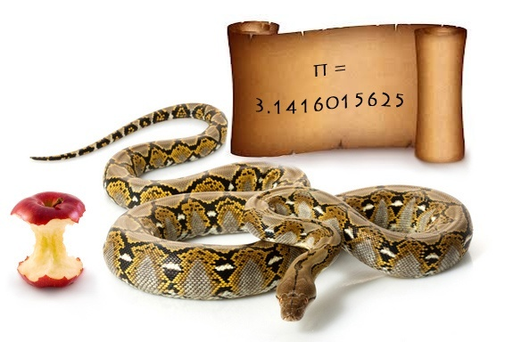
The “Original Sin” of Computer Math
“The computer cannot give you the exact value, sorry. Use this value instead. It’s close.”
Notes:
You might have thought computer math was a pretty geeky thing to talk about at a TTI Vanguard conference, but it turns out that the acceptance of “there has to be rounding error, so just deal with it” has led to disasters costing hundreds of millions of dollars each, and even costing people’s lives. What do most programmers do about rounding error? They demand WAY TOO MUCH PRECISION, hoping to push the error far enough away that it probably won’t hurt the answer. Probably. And what does that excess precision do? It wastes memory, bandwidth, energy, and storage, that’s what!

Slide 10
A Key Idea: The Ubit
We have always had a way of expressing reals correctly with a finite set of symbols.
Incorrect: π = 3.14
Correct: π = 3.14…
The latter means 3.14 < π < 3.15, a true statement.
Presence or absence of the “…” is the ubit, just like a sign bit. It is 0 if exact, 1 if there are more bits after the last fraction bit, not all 0s and not all 1s.

Slide 11
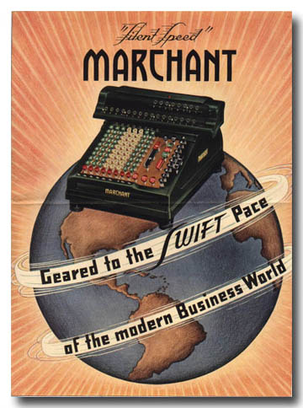
Floats designed for visible scratch work
OK for manual calculations
Operator sees, remembers errors
Can head off overflow, underflow
Automatic math hides all that
No one sees processor “flags”
Disobeys algebraic laws
Wastes bit patterns as NaN values (NaN = Not a Number)
IEEE 754 “standard” is really the IEEE 754 guideline; optional rules spoil consistent results
Notes:
Have you ever seen those old mechanical desk calculators? The computed about one digit of the answer every second, clanking away. A room full of those desk calculators were operated by people, usually women, called “computers”. A room full of computers, the people kind, did all the calculations used for the design of the first atomic bomb in 1945. Funny to think that the US government worries about us shipping powerful computers to other countries because they might allow them to design a nuclear weapon! Anyway, as soon as computers like the IBM 701 became widespread, it was the numerical equivalent of handing a gun to a five-year-old. Programmers gleefully attempted to use textbook algebra to solve problems, and when the answers came out so inaccurate as to be useless, it could take weeks to figure where in the automatic calculation things went wrong.

Slide 12
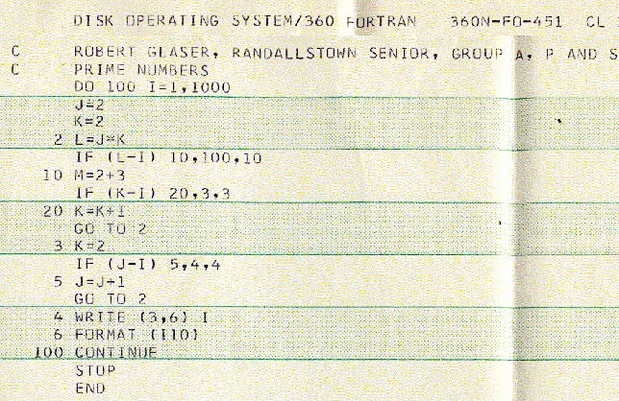
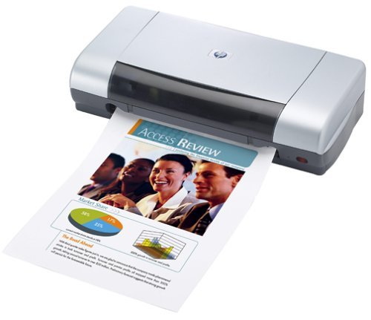
Analogy: Printing in 1970 vs. 2015
1970: 30 sec per page
2015: 30 sec per page
Faster technology is for better prints, not thousands of low-quality prints per second.
Why not do the same thing with computer arithmetic?

Slide 13
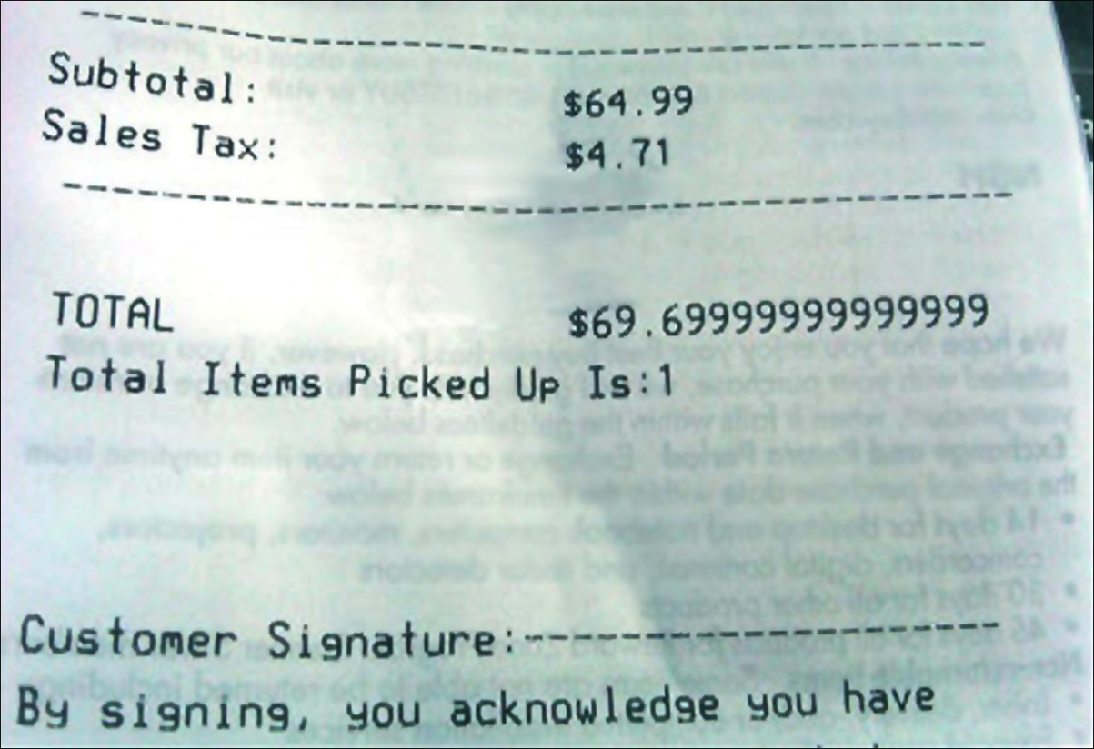
This is just… sad.

Slide 14
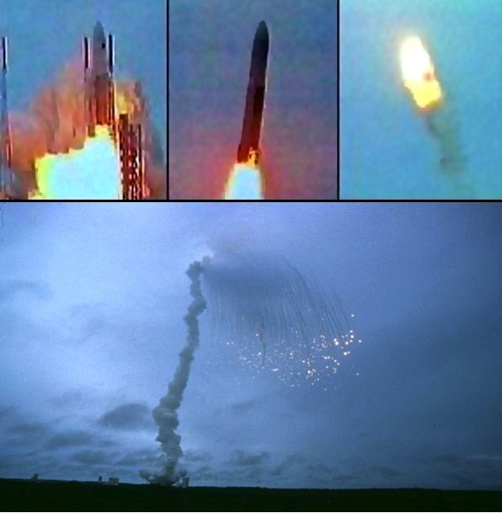
Float Disaster: The Ariane 5
64-bit float measured speed
16-bit guidance system; oops
$0.7 billion gone in seconds
Why do programmers have to manage storage sizes when computers are much better at doing it?

Slide 15
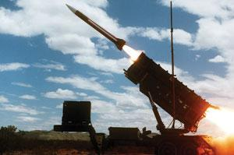
When rounding error killed 38 people
First Gulf War
Left on for 100 hours
Fraction “crowded out” by integer part
Guidance off by 0.43 seconds
Patriot missed Scud
Scud struck barracks

Slide 16
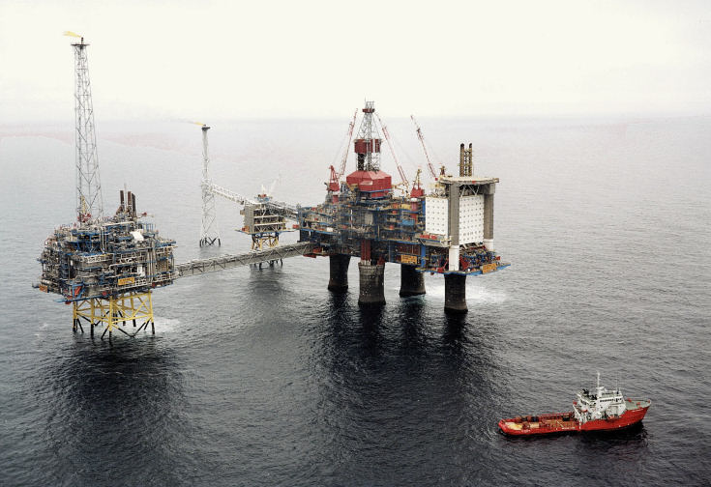

The Sleipner Oil Platform Disaster
Float error in structural analysis; collapsed to ocean floor
~$1 billion loss (in 2015 dollars)
August 23, 1991
August 24, 1991
Oops.

Slide 17
Floats prevent use of parallelism
No associative property for floats
(a + b) + (c + d) (parallel) ≠ ((a + b) + c) + d (serial)
Looks like a “wrong answer”
Programmers trust serial, reject parallel
IEEE floats report rounding, overflow, underflow in processor register bits that no one ever sees.

Slide 18

A New Number Format: The Unum
Universal numbers
Superset of IEEE types, both 754 and 1788
Integers➔floats➔unums
No rounding, no overflow to ∞, no underflow to zero
They obey algebraic laws!
Safe to parallelize
Fewer bits than floats
But… they’re new
Some people don’t like new
“You can’t boil the ocean.”
—Former Intel exec, when shown the unum idea

Slide 19
Three ways to express a big number
Avogadro’s number: ~6.022×10²³ atoms or molecules
Sign-Magnitude Integer (80 bits):
0 1111111100001010101001111010001010111111010100001001010011000000000000000000000
sign
Lots of digits
IEEE Standard Float (64 bits):
0 10001001101 1111111000010101010011110100010101111110101000010011
sign
exponent (scale)
fraction
Unum (29 bits, here):
utag
Self-descriptive “utag” bits track and manage uncertainty, exponent size, and fraction size
0 11001101 111111100001 1 111 1011
sign
exp.
frac.
ubit
exp. size
frac. size

Slide 20
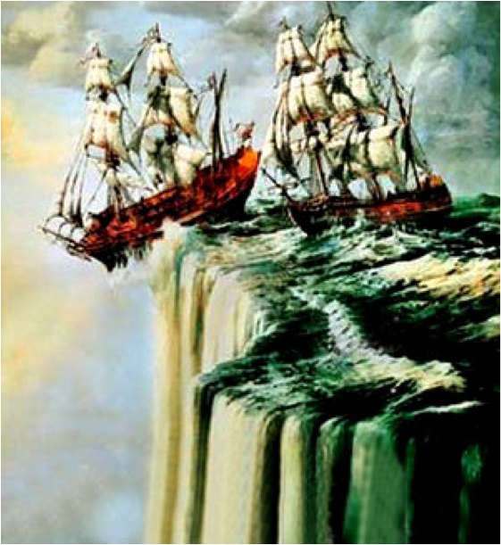
Fear of overflow wastes bits, time
Huge exponents… why?
Fear of overflow, underflow
Easier for hardware designer
Universe size / proton size: 10⁴⁰
Single precision float range: 10⁸³
Double precision float range: 10⁶³²

Slide 21
Why unums use fewer bits than floats
Exponent smaller by about 5 – 10 bits, typically
Trailing zeros in fraction compressed away, saves ~2 bits
Shorter strings for more common values
Cancellation removes bits and the need to store them
IEEE Standard Float (64 bits):
0 10001001101 1111111000010101010011110100010101111110101000010011
Unum (29 bits) (for example):
0 11001101 111111100001 1 111 1011

Slide 22
A Typesetting Analogy
The biggest objection to unums is likely to come from the fact that they are variable in size, at least when they are stored in packed form.
The biggest objection to unums is likely to come from the fact that they are variable in size, at least when they are stored in packed form.
18-point Courier
(fixed width font)
18-point Times
(variable width font)
This shows the price of “One Size Fits All.”

Slide 23
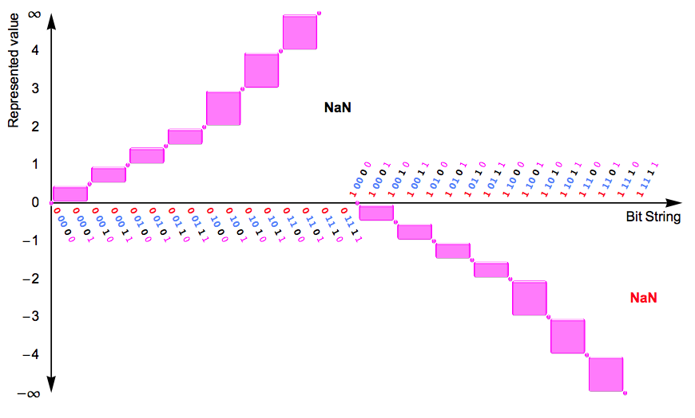
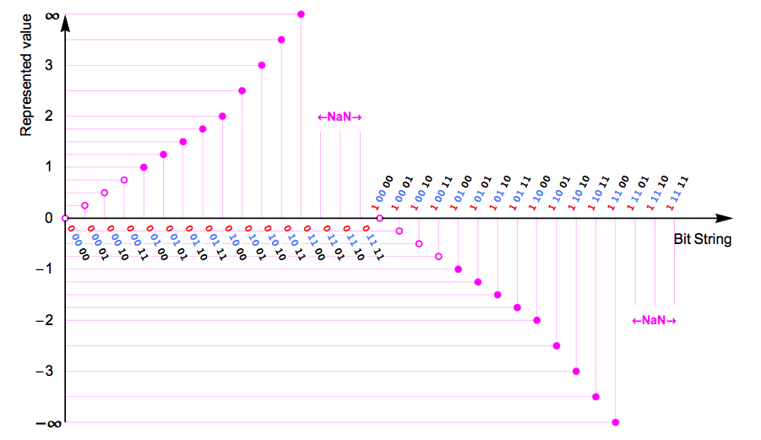
Open ranges, as well as exact points
Bit string meanings
using IEEE Float rules
Bit string meanings
in unum format
Complete representation of all real numbers using a finite number of bits

Slide 24

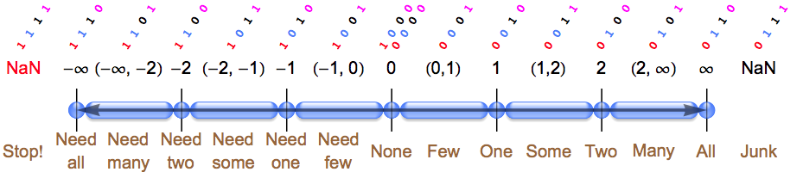
The Warlpiri unums
Before the aboriginal Warlpiri of Northern Australia had contact with other civilizations, their counting system was “One, two, many.”
Maybe they were onto something.
“Try everything” methods become feasible.

Slide 25
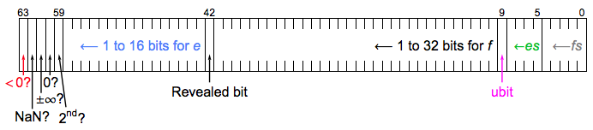
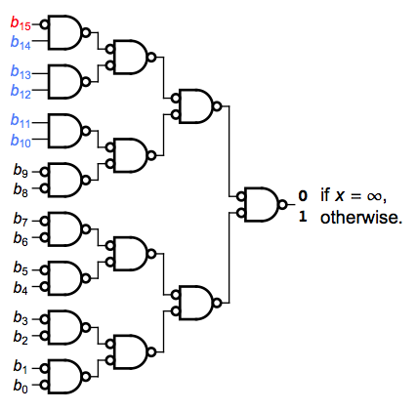

Fixed-size unums: faster than floats
Warlpiri ubounds are one byte, but closed system for reals
Unpacked unums pre-decode exception bits, hidden bit
Circuit required for
“IEEE half-precision float = ∞?”
Circuit required for
“unum = ∞?”
(any precision)

Slide 26
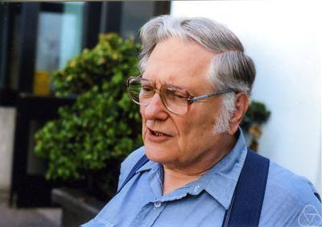
Floating Point II: The Wrath of Kahan
Berkeley professor William Kahan is the father of modern IEEE Standard floats
Also the authority on their many dangers
Every idea to fix floats faces his tests that expose how new idea is even worse
Working unum environment completed August 13, 2013.
Can unums survive the wrath of Kahan?

Slide 27
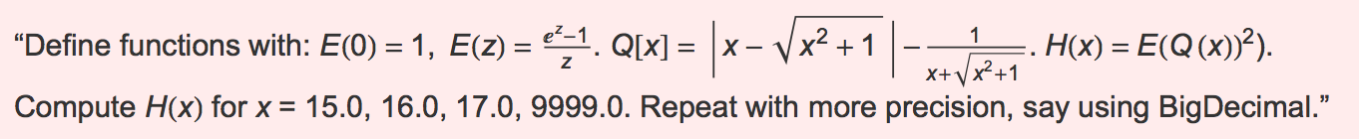
Typical Kahan Challenge (invented by J-M Müller)
Correct answer: (1, 1, 1, 1).
IEEE 32-bit: (0, 0, 0, 0) FAIL
IEEE 64-bit: (0, 0, 0, 0) FAIL
Myth: “Getting the same answer with increased precision means the answer is correct.”
IEEE 128-bit: (0, 0, 0, 0) FAIL
Extended precision math packages: (0, 0, 0, 0) FAIL
Interval arithmetic: Um, somewhere between –∞ and ∞. EPIC FAIL
Unums, 6-bit average size: (1, 1, 1, 1) CORRECT
I have been unable to find a problem that “breaks” unum math.

Slide 28
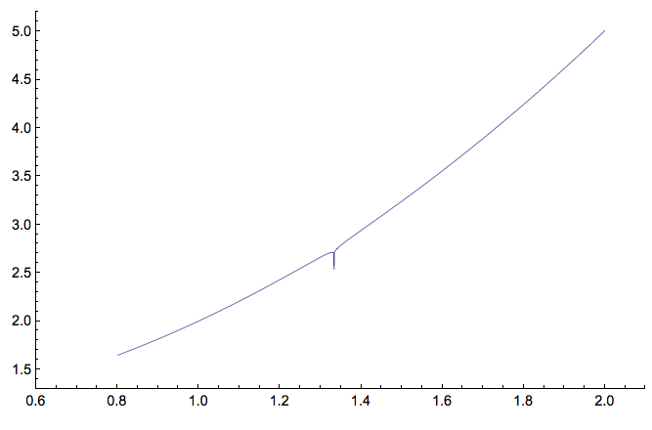
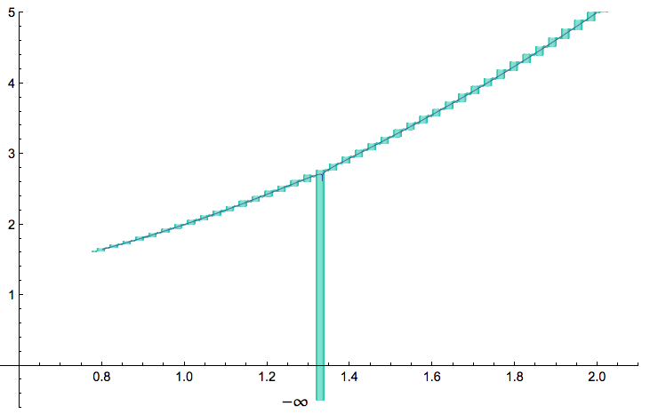
Kahan’s “Smooth Surprise”
Find minimum of log(|3(1–x)+1|)/80 + x² + 1 in 0.8 ≤ x ≤ 2.0
Plot, test using half a million
double-precision IEEE floats.
Shows minimum at x = 0.8.
FAIL
Plot, test using a few dozen
very low-precision unums.
Shows minimum where
x spans 4/3.
CORRECT
Even if you test every float in the
range, it will fail to detect the minimum!

Slide 29
Rump’s Royal Pain
Compute 333.75y⁶ + x²(11x²y² – y⁶ – 121y⁴ – 2) + 5.5y⁸ + x/(2y)
where x = 77617, y = 33096.
Using IBM (pre-IEEE Standard) floats, Rump got
1.172603 in 32-bit precision
1.1726039400531 in 64-bit precision
1.172603940053178 in 128-bit precision
Correct answer: –0.82739605994682136…! Didn’t even get sign right
Unums: Correct answer to 23 decimals using an average of only 75 bits per number. Not even IEEE 128-bit precision can do that. Precision, range adjust automatically.

Slide 30
Some principles of unum math
Bound the answer as tightly as possible within the numerical environment, or admit defeat.
No more guessing
No more “the error is O(h^{n})” type estimates
The smaller the bound, the greater the information
Performance is information per second
Maximize information per bit
Fused operations are always explicitly distinct from their non-fused versions, so results are bitwise identical across platforms

Slide 31
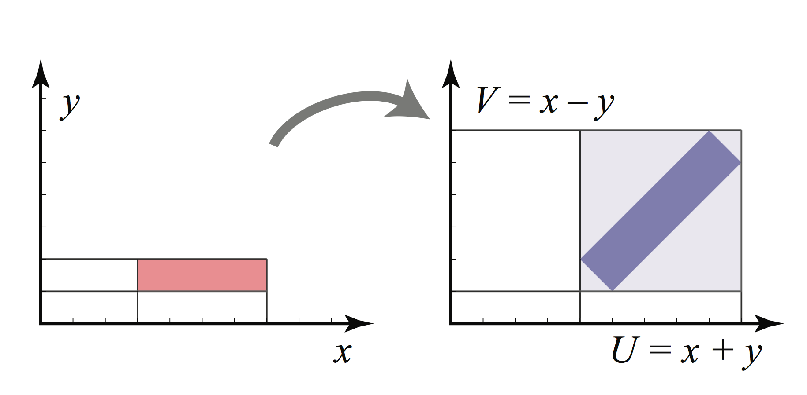
Reason 1 why interval math hasn’t displaced floats: The “Wrapping Problem”
Answer sets are complex shapes in general, but interval bounds are axis-aligned boxes, period.
No wonder interval bounds grow far too fast to be useful, in general!

Slide 32
Reason 2: The Dependency Problem
What wrecks interval arithmetic is simple things like
F(x) = x – x.
Should be 0, or maybe [–ε, +ε]. Say x is the interval [3, 4], then interval x – x stupidly evaluates to [–1, +1], which doubles the uncertainty (interval width) and makes the interval solution far inferior to the point arithmetic method.
The unum architecture solves both drawbacks of traditional interval arithmetic.

Slide 33
Accuracy on a 32-bit budget: a contest
For fair comparison of different number systems, put them all on a strict diet of 32 bits, and compare their accuracy.
Say we want to compute
and we try
32-bit IEEE floats
Interval arithmetic [a,b] where a and b are 16-bit floats
Unum arithmetic with average size less than 32 bits

Slide 34
Contest results: Floats
Correct answer, to 20 decimals: 1.9566500918359210527…
32-bit IEEE floats: 1.95669615268707275390625
5 decimals correct
Off by 486 ULPs
No indication of what the accuracy is
The nominal accuracy of 32-bit IEEE floats is 7+ decimals.

Slide 35
Contest results: Intervals
16-bit IEEE floats have 3+ decimal accuracy and a dynamic range of about 9 orders of magnitude.
Example of an interval bound:
e = 2.71828… is represented by [2.716796875, 2.71875].
Result given by interval math:
[0.99853515625, 5.009765625]
????
No decimals correct
A rigorous bound, but uselessly pessimistic

Slide 36
Contest results: Unums
Using 9 bits in the self-descriptive utag, unums can take anywhere from 12 to 78 bits, but we can cap it at 44 bits.
With an average length of 31.5 bits, the unum result is the open interval
(1.9566497802734375, 1.956650257110595703125)
This bound is sixty times more accurate than the float result and it guarantees the bound.
With 32 bits as the maximum size permitted, we get an average size of 22.8 bits, and the interval
1.953125, 1.9609375)

Slide 37
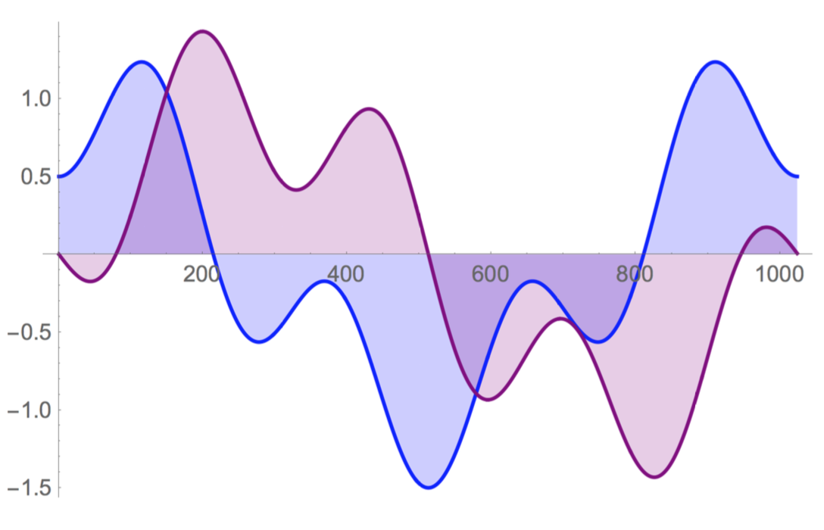
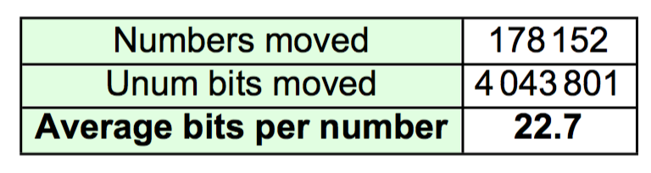
An Experiment that should interest SKA: Fast Fourier Transforms with unums
Standard test: Complex 1024-point FFT, in-place.
12-bit input data, like A-to-D convertors produce
Utag adds 6 bits to each value, but…
Bounds,
not guesses!

Slide 38
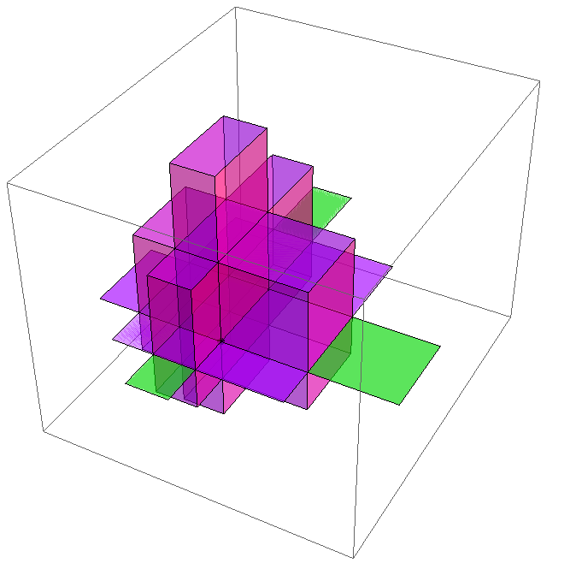
Uboxes and solution sets
A ubox is a multidimensional unum
Exact or ULP-wide in each dimension (Unit in the Last Place)
Sets of uboxes constitute a solution set
One dimension per degree of freedom in solution
Solves the main problems with interval arithmetic
Super-economical for bit storage
Data parallel in general

Slide 39
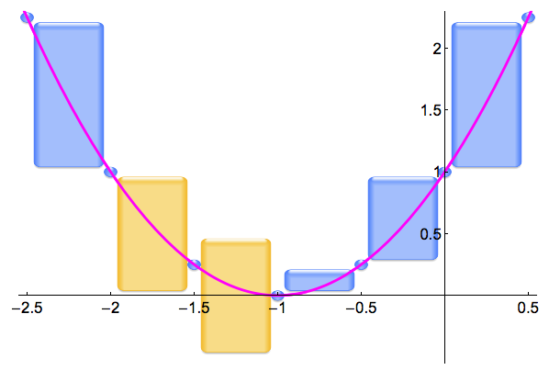
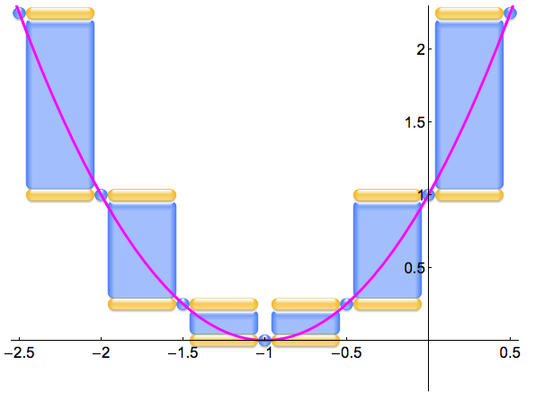
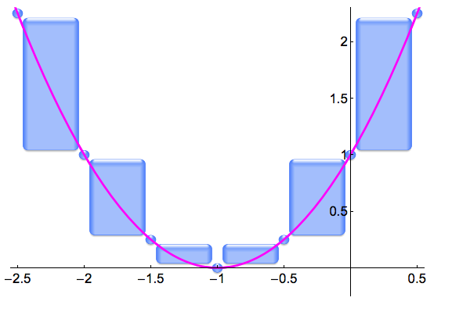
Polynomials: bane of classic intervals
Dependency and closed endpoints lose information (amber)
Unum polynomial evaluator loses no information.

Slide 40
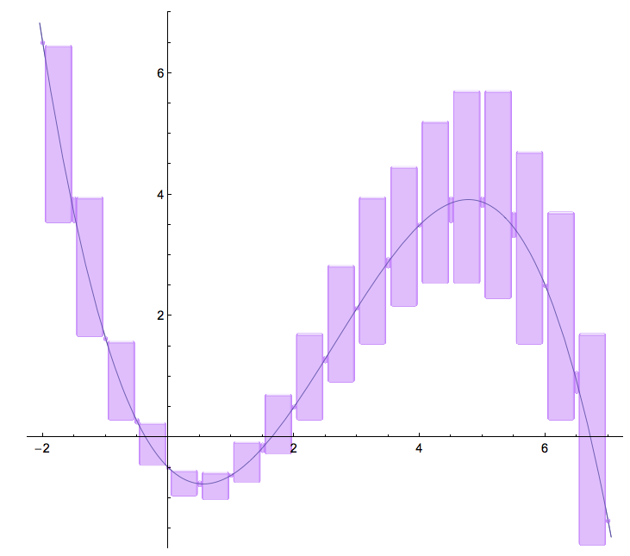
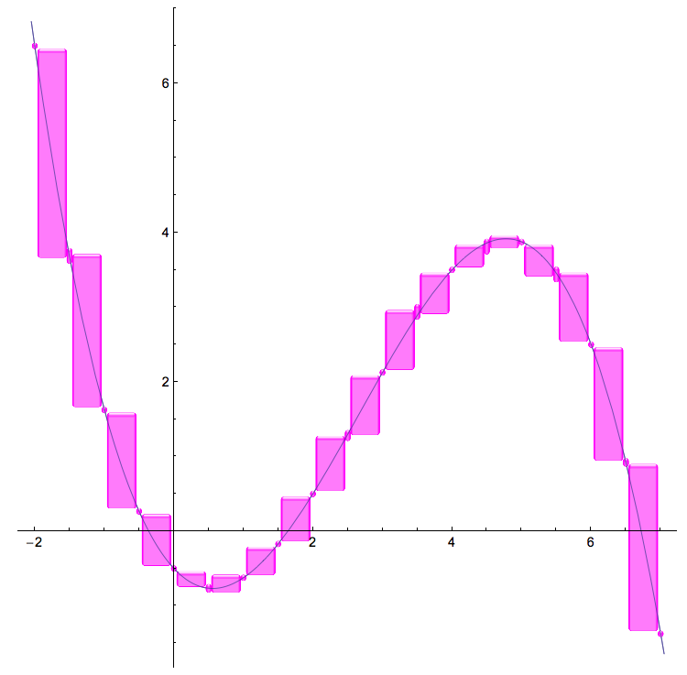
Polynomial evaluation solved at last
Mathematicians have sought this for at least 60 years.
“Dependency Problem” creates sloppy
range when input is an interval
Unum evaluation refines answer to limits of the environment precision

Slide 41
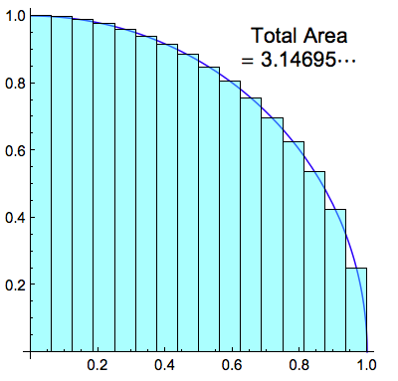
The Deeply Unsatisfying Error Bounds of Classical Analysis
4x
Classical numerical texts teach this “error bound”:
What is f ′′? Where is ξ ? What is the bound??
Bound is often infinite, which means no bound at all
“Whatever it is, it’s four times better if we make h half as big” creates demand for supercomputing that cannot be satisfied.
Error ≤ (b – a) h² |f ′′(ξ)| / 24

Slide 42

Quarter-circle example
Suppose all we know is x² + y² = 1, and x and y are ≥ 0.
Suppose we have at most 2 bits exponent, 4 bits fraction.
Task:
Bound the quarter circle area.
(i.e., bound the value of π/4)
Create the pixels for the shape.

Slide 43
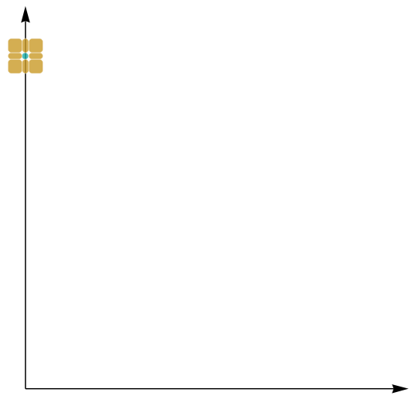
Set is connected; need a seed
We know x = 0, y = 1 works
Find its eight ubox neighbors in the plane
Test x² + y² = 1, x ≥ 0, y ≥ 0
Solution set is green
Trial set is amber
Failure set is red
Stop when no more trials

Slide 44
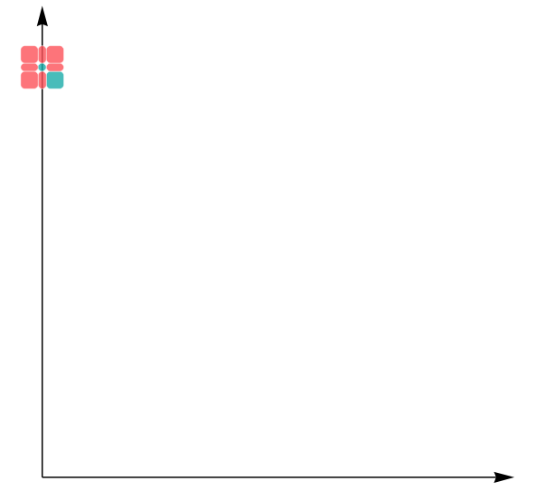
Exactly one neighbor passes
Unum math automatically excludes cases that floats would accept
Trials are neighbors of new solutions that
Are not already failures
Are not already solutions
Note: no calculation of
Not part of the unit circle

Slide 45
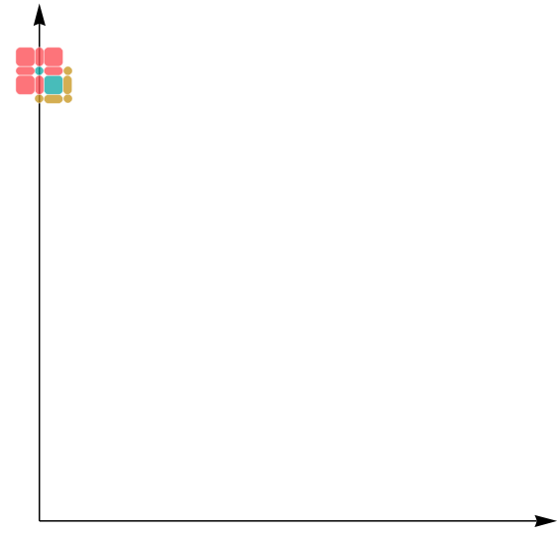
The new trial set
Five trial uboxes to test
Perfect, easy parallelism for multicore
Each ubox takes only 15 to 23 bits
Ultra-fast operations
Skip to the final result…

Slide 46
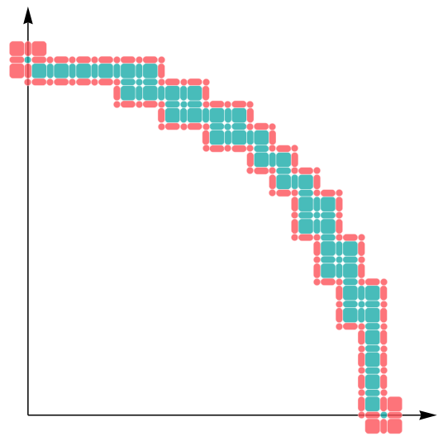
The complete quarter circle
The complete solution, to this finite precision level
Information is reciprocal of green area
Use to find area under arc, bounded above and below
Proves value of π to an accuracy of 3%
No calculus needed, or divides, or square roots

Slide 47
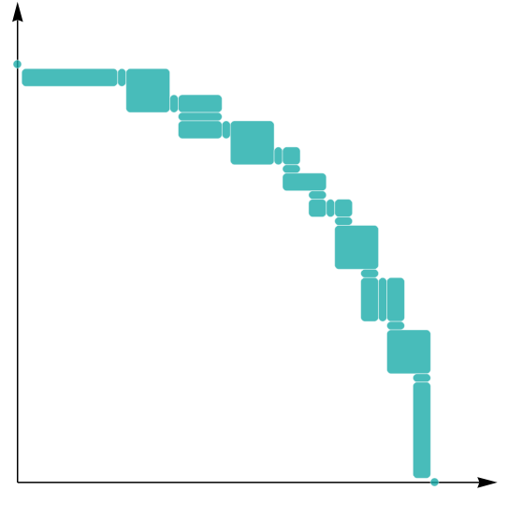
Compressed Final Result
Coalesce uboxes to largest possible ULP values
Lossless compression
Total data set: 603 bits!
6x faster graphics than current methods
Instead of ULPs being the source of error, they are the atomic units of computation

Slide 48
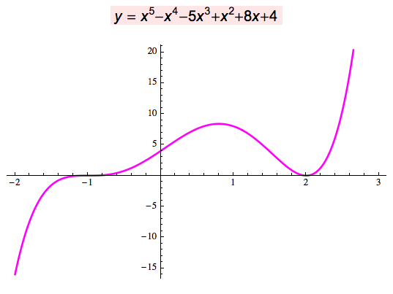
Fifth-degree polynomial roots
Analytic solution: There isn’t one.
Numerical solution: Huge errors from underflow to zero
Unums: quickly return x = –1, x = 2 as the exact solutions. No rounding. No underflow. Just… the correct answer. With as few as 4 bits for the operands!

Slide 49
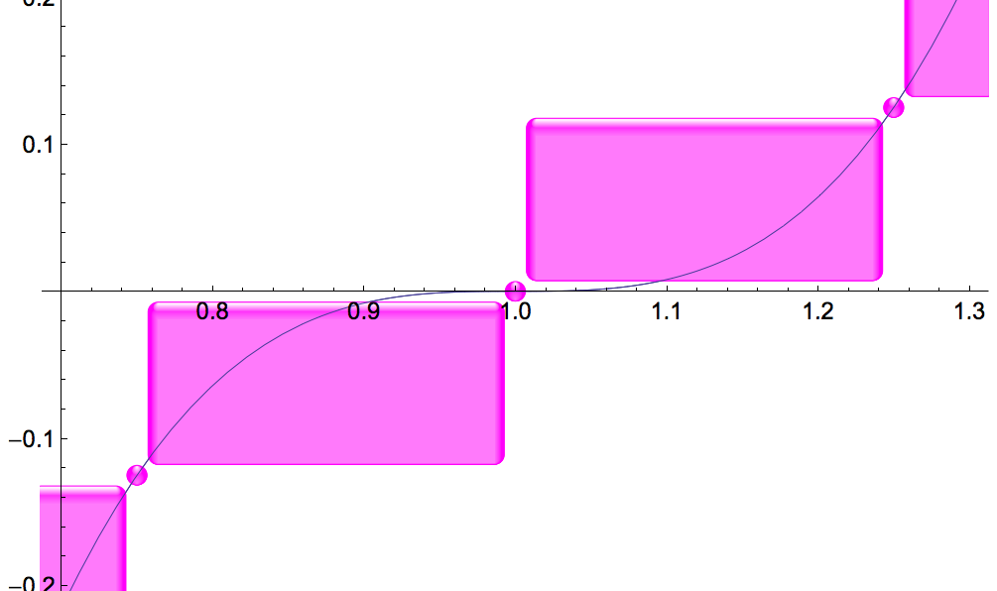
The power of open-closed endpoints
Root-finding just works.

Slide 50

Classical Numerical Analysis
Time steps
Use position to estimate force
Use force to estimate acceleration
Update the velocity
Update the position
Lather, rinse, repeat
Accumulates rounding and sampling error, both unknown
Cannot be done in parallel
start
Δt
Δt
Δt
Δt
Actual behavior
M

Slide 51

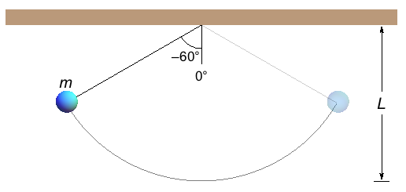
Pendulums Done Right
Physics teaches us it’s a harmonic oscillator with period
Force-fits nonlinear ODE into linear ODE for which calculus works.
WRONG answer

Slide 52
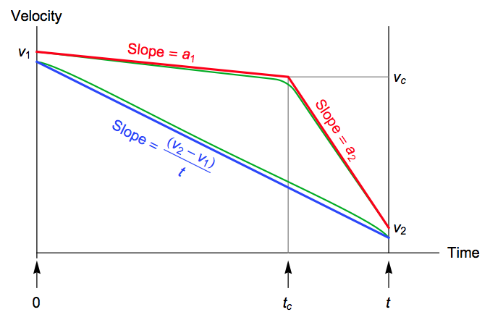
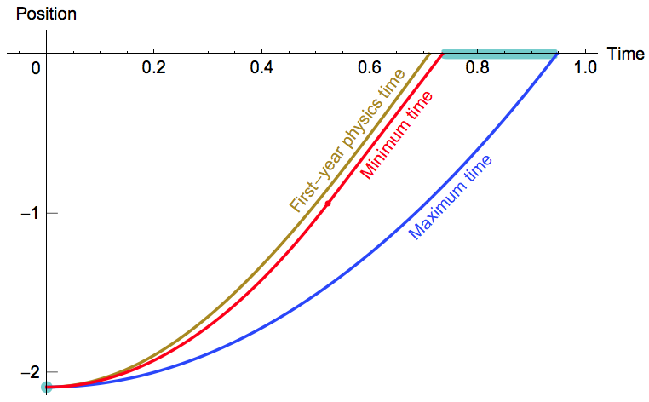
A New Type of Parallelism
Space steps, not time steps
Acceleration, velocity bounded in any given space interval
Find traversal time as a function of space step (2D ubox)
Massively parallel!
No rounding error
No sampling error
Obsoletes existing ODE methods

Slide 53
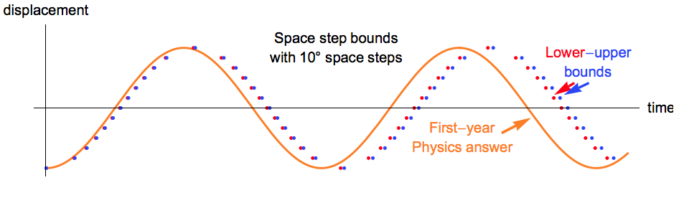
Physical Truth vs. Force-Fit Solution
Traditional approach bends the problem to fit
known solution methods, gets wrong answer

Slide 54
Uboxes for linear solvers
If the A and b values in Ax=b are rounded, the “lines” have width from uncertainty
Apply a standard solver, and get the red dot as “the answer”, x. A pair of floating-point numbers.
Check it by computing Ax and see if it rigorously contains b. Yes, it does.
Hmm… are there any other points that also work?

Slide 55
Float, Interval, and Ubox Solutions
Point solution (black dot) just gives one of many solutions; disguises answer instability
Interval method (gray box) yields a bound too loose to be useful
The ubox set (green) is the best you can do for a given precision
Uboxes reveal ill-posed nature… yet provide solution anyway
Works equally well on nonlinear problems!

Slide 56
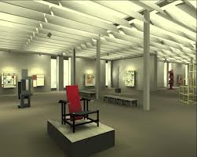
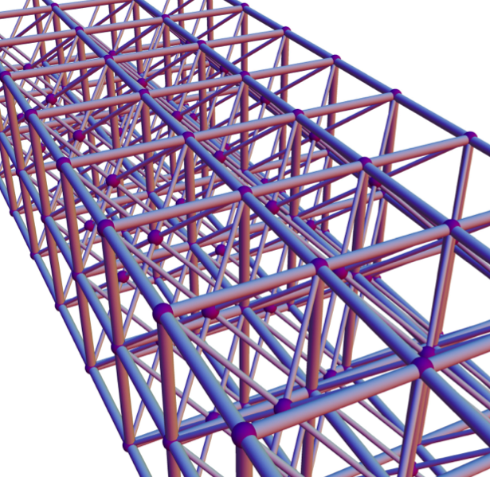
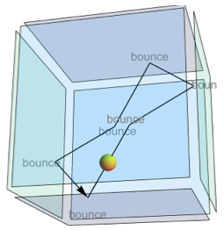
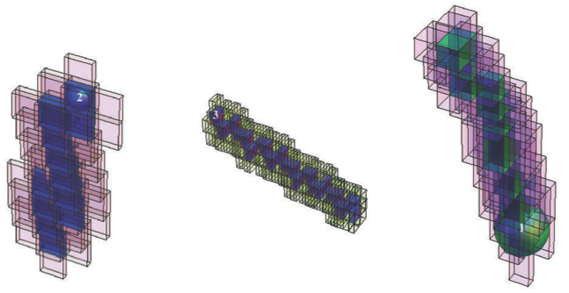
Other Apps with Ubox Solutions
Photorealistic computer graphics
N-body problems
Structural analysis
Laplace’s equation
Perfect gas models without statistical mechanics
Imagine having provable bounds on answers for the first time, yet with easier programming, less storage, less bandwidth use, less energy/power demands, and abundant parallelism.

Slide 57
Revisiting the Big Challenges-1
Too much energy and power needed per calculation
Unums cut the main energy hog (memory transfers) by about 50%
More hardware parallelism than we know how to use
Uboxes reveal vast sources of data parallelism, the easiest kind
Not enough bandwidth (the “memory wall”)
More use of CPU transistors, fewer bits moved to/from memory
Rounding errors more treacherous than people realize
Unums eliminate rounding error, automate precision choice
Rounding errors prevent use of multicore methods
Unums restore algebraic laws, eliminating the deterrent

Slide 58
Revisiting the Big Challenges-2
Sampling errors turn physics simulations into guesswork
Uboxes produce provable bounds on physical behavior
Numerical methods are hard to use, require expertise
“Paint bucket” and “Try everything” are brute force general methods that need no expertise… not even calculus

Slide 59
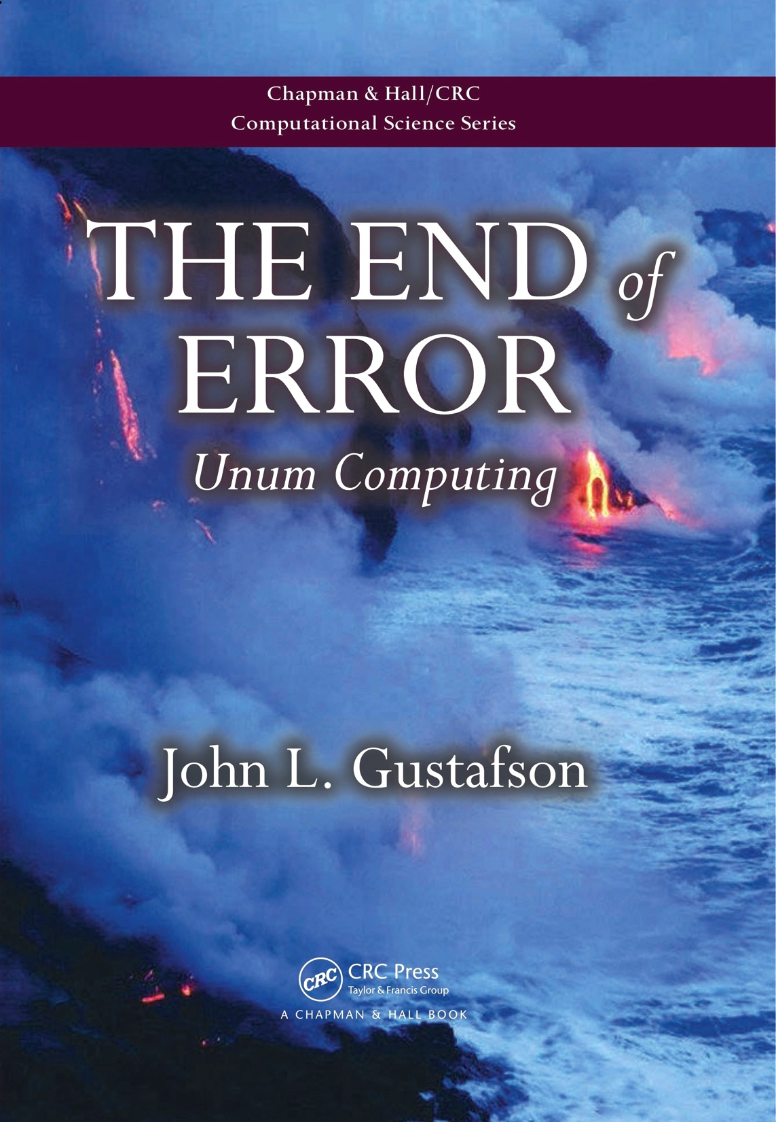
The End of Error
A complete text on unums and uboxes was published Feb 2015 (CRC Press)
Aimed at general reader; mathematicians hate its casual, accessible style
Complete prototype environment is available as free Mathematica notebook through publisher
Amazon #1 Best Seller in Number Systems; they keep running out of copies

Slide 60
Work in Progress
Unum data types are now in Julia (funded by A*STAR)
Alan Edelman, MIT
Viral Shah, Julia Computing
Deepak Vinchhi, Julia Computing
Isaac Yonemoto, REX Computing
Jeffrey Sarnoff, Diadem Special Projects
Job Van Der Zwan, julia-users@googlegroups.com
Thomas Breloff, Cointegrated Technologies
61 repository results on github, too many to list here
A Python version of the prototype environment exists: https://github.com/dpsanders/pyunum

Slide 61
Work in Progress
Lawrence Livermore National Lab
David Jefferson
Charles Reynolds
Robin Goldstone
Dan Quinlan
Markus Schordan
5 others
University of California Santa Barbara
Carlos Maltzahn is creating open source community for unums; student hired
Karlsruhe Institute of Technology
Ulrich Kulisch has formalized unum definition, proposed fixed-size implementation
IEEE
2015 President Tom Conte has urged creation of a unum IEEE Standard

Slide 62
Work in Progress
Convert Mathematica prototype into a C library
Elavarasi Manogaran and Himeshi DeSilva, NUS
Basic arithmetic + – * / working as of last week. 2 million ops per second.
FPGA version
A*STAR intends to fund and staff one of several efforts
Custom VLSI processor
Initially with fixed-size data, plus lossless pack and unpack
Eventually, bit-addressed architecture with hardware memory management (similar to disc controller)
Fundamentally different kind of processor design, incl. integer ops
REX Computing will put unums in next version of their CPU
A different unum approach discovered in February 2016 is super-fast and hardware-friendly. Hear about it in tomorrow’s talk!
The ocean is already starting to boil. Thank you!

